Slide 1
The impacts of
Industrial/Commercial Recycling Centers in District 5

Slide 2
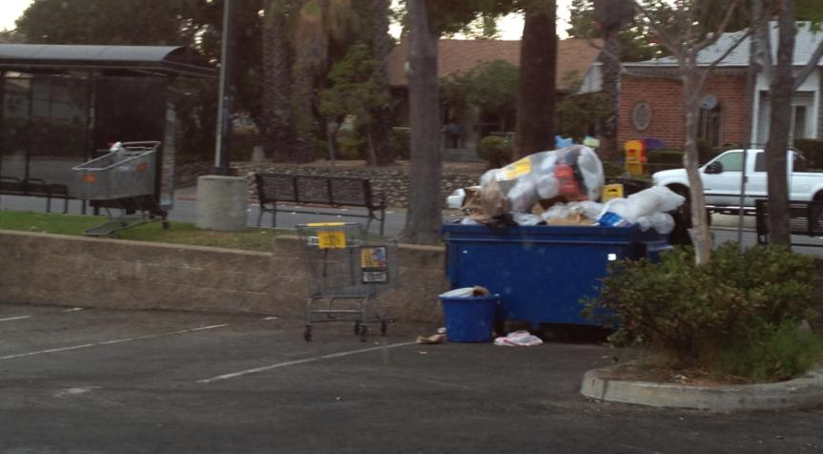

Slide 3
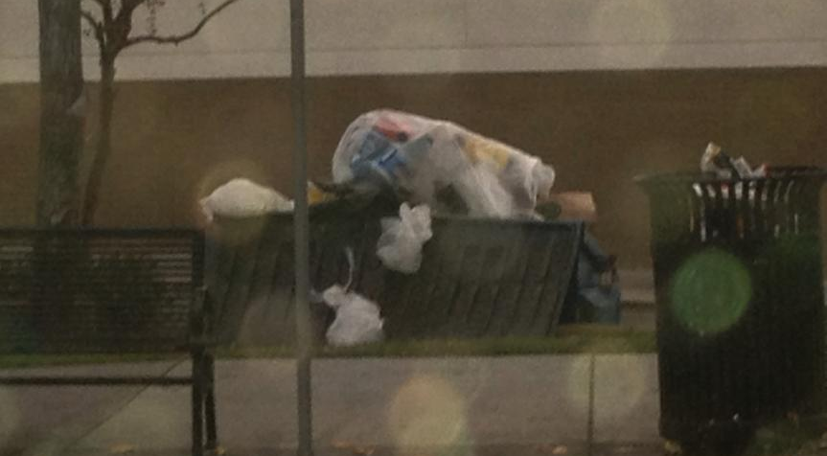

Slide 4
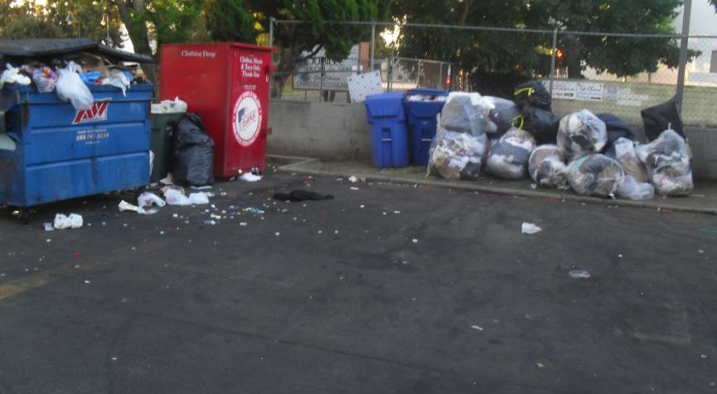

Slide 5
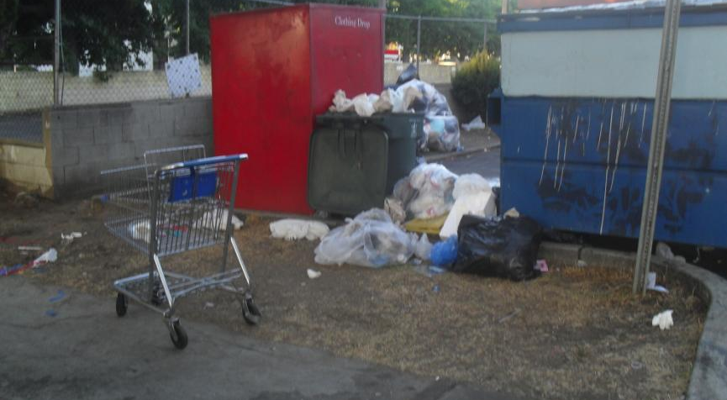

Slide 6


