Slide 1
1727-1787 East Walnut Avenue and
235 North Allen Avenue
Predevelopment Plan Review
City Council Meeting
May 20, 2013

Slide 2
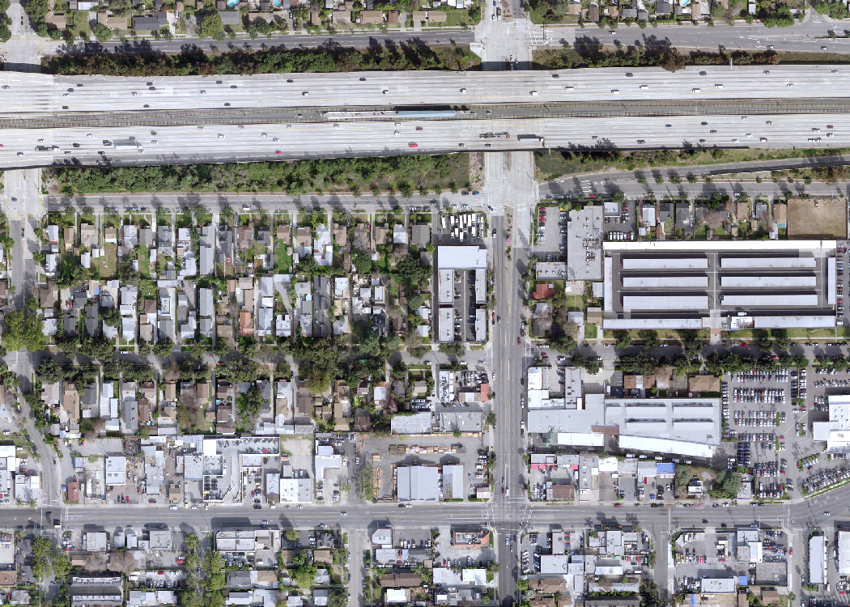
Vicinity Map
Allen
Gold Line
Station
E Corson St
Locust St
N Allen Ave
Project Site
E Walnut St

Slide 3
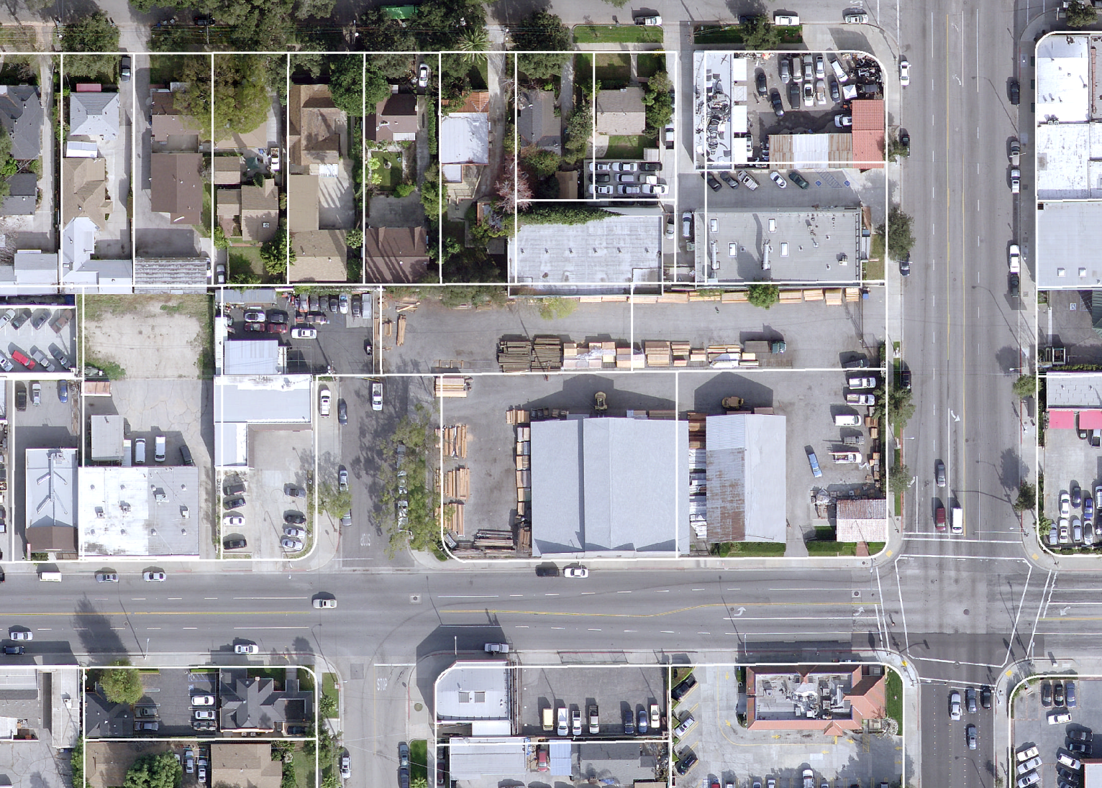
Subject Site
Locust St
RM-16
N Allen Ave
CG
N Meridith
Ave
E Walnut St
ECSP-CG-3

Slide 4
Background
Zoning: CG (Commercial General) and ECSP-CG-3 (East Colorado Specific Plan, Sub-area 3).
Eastern part of site located in the Gold Line area of the East Colorado Specific Plan
Entire site within a Transit Oriented District (TOD)
Davis Lumber (closed June 2012) & auto repair.
Five parcels (and vacated Meridith Ave.) comprise site:
  CG (west) portion – 0.44 acres
  ECSP-CG-3 (east) portion – 1.42 acres

Slide 5
Project Description
Mixed-Use Project
  128 Rental Apartments.
  5,000 square feet of commercial space.
  217 parking spaces, including one level of subterranean parking.
  Two buildings:
    West: 25 units in three stories
    East: 103 units in four stories
  Meridith Avenue is proposed to be vacated.

Slide 6
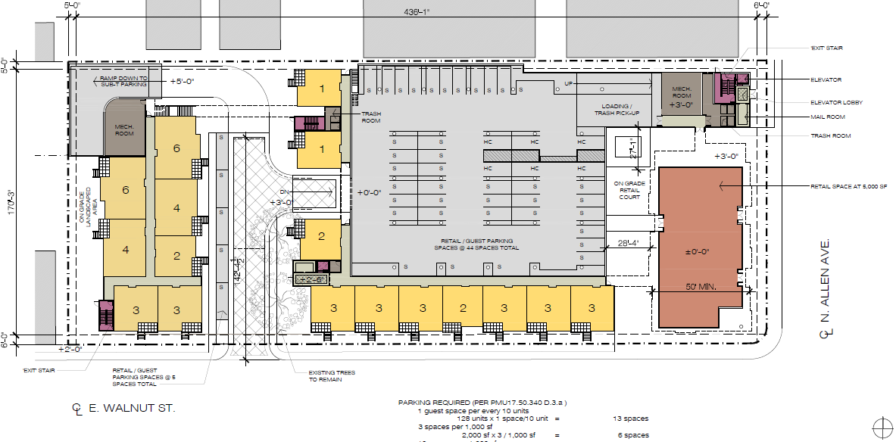
Project Description
N. Meridith Ave.
N. Allen Ave.
E. Walnut St.

Slide 7
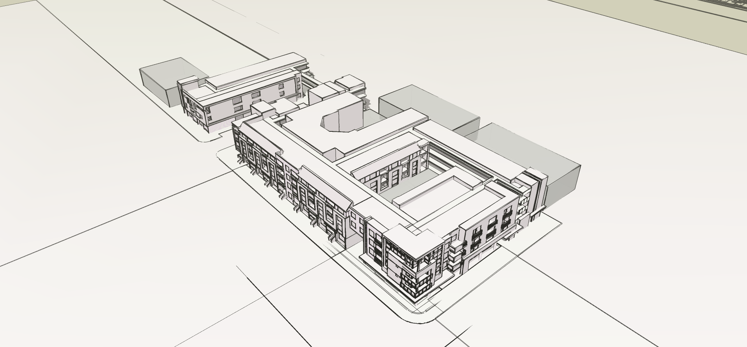
Perspective
Conditional Use Permit For Housing
Meridith Ave.
Street Vacation

Slide 8
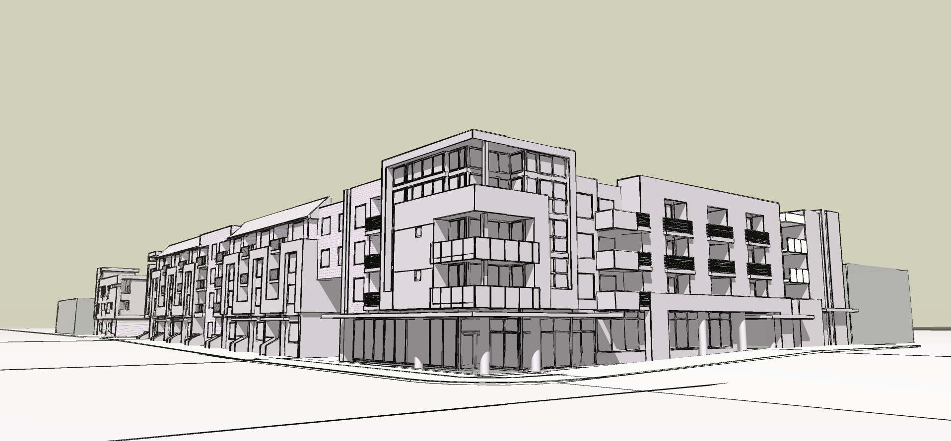
Perspective

Slide 9
Discretionary Entitlements
Entitlements:
  Street Vacation of Meridith Avenue.
  Conditional Use Permit to construct housing on the CG-zoned portion of the site; and
  Design Review.
Review Authorities:
  Planning Commission makes recommendation on Street Vacation, Conditional Use Permit, and environmental review to City Council;
  City Council to make final decision; and
  Design Commission to conduct design review.

Slide 10
Planning Division Comments
Topics related to Zoning Code compliance:
  Residential Density/Density Bonus: 21% Density Bonus to exceed 106 unit maximum up to 128 units;
  Setbacks: setback of at least 15 feet along north side of western building;
  Height: height maximum differs between CG (45 feet) and ECSP (60 feet) districts;
  Parking: subject to mandatory parking reductions for Transit-Oriented Development projects; and
  Size: building on CG portion exceeds 0.80 FAR (at 1.09; redesigned to comply).

Slide 11
Planning Division Comments
Topics related to Design & Historic Preservation:
  Massing: relate contextually to urban site;
  Siting: well-sited at Walnut/Allen intersection with emphasis on the corner design element;
  Compatibility: new building must be example for projects in future;
  Landscaping: interconnected landscaped and hardscaped areas that encourage pedestrian activity; and
  Materials: durable, high-quality materials.

Slide 12
Planning Division Comments
East Colorado Specific Plan:
  Project should create a strong urban edge;
  Project should create opportunities for a pedestrian oriented streetscape;
  Improve key intersections and establish gateways that help establish a sense of place; and
  Include higher density residential with a mix of commercial development with retail on the ground floor and residential and/or office above.

Slide 13
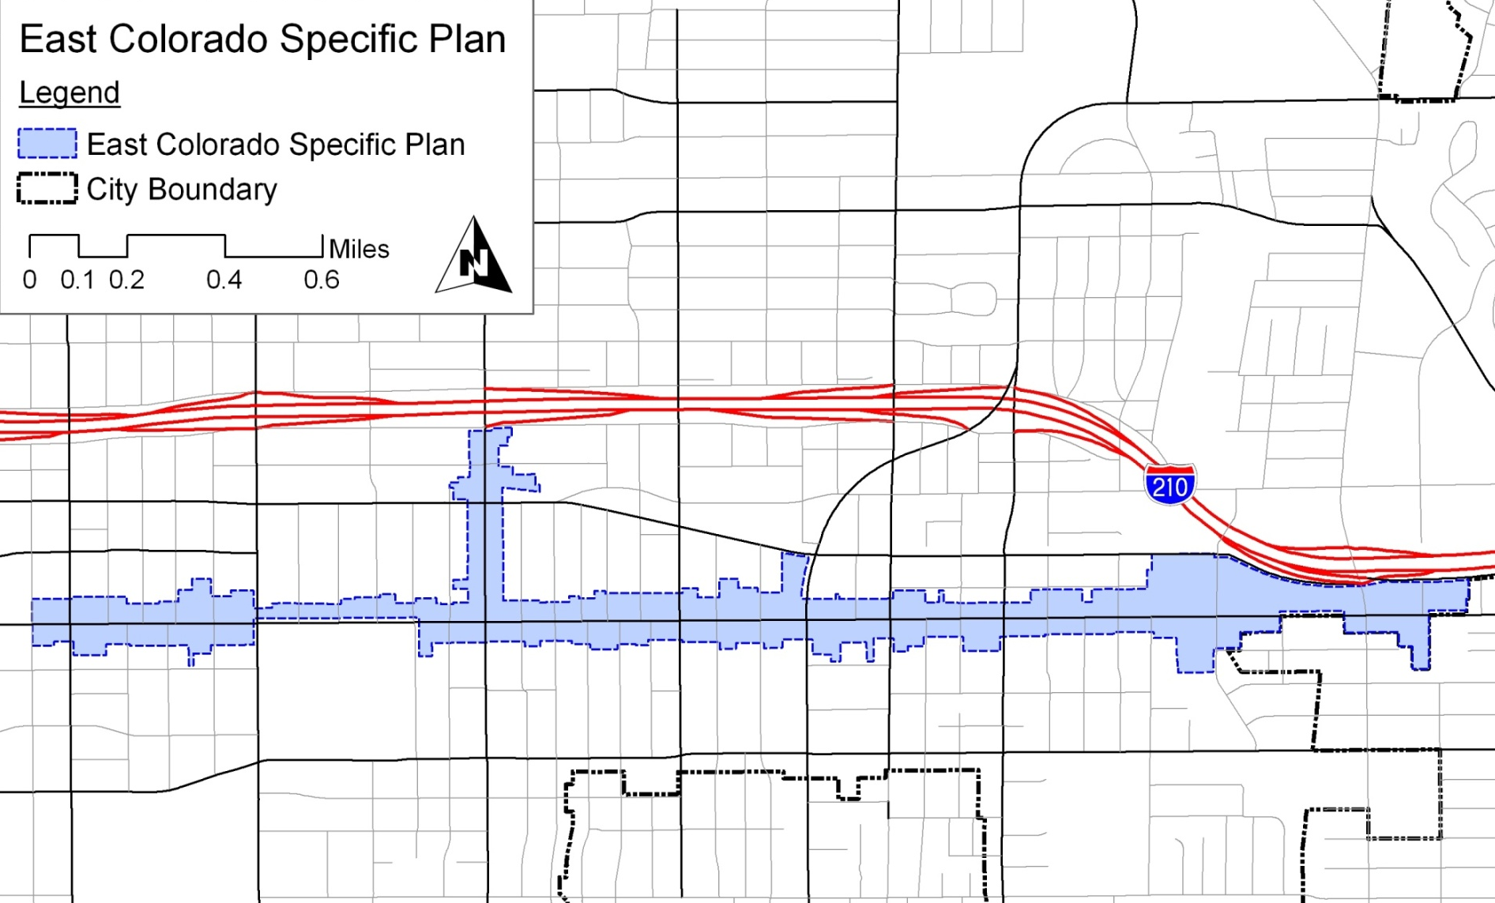
Existing General Plan
Project Site
Walnut St.
Colorado Blvd.
PCC
Sierra Madre Blvd.
Del Mar Ave.
Catalina Ave.
Allen Ave.
Madre St.
Hill Ave.

Slide 14
Existing General Plan
Remaining caps from the 1994 General Plan for the East Colorado Specific Plan:
  736 Housing Units.
    General Plan allows housing units to be converted to non-residential square feet utilizing a conversion factor
    Each residential unit may be converted to commercial floor area at a rate of 1,000 square feet per unit.
  143,322 square feet of commercial development.
  100,000 square feet of institutional development.
Project is within these allocations.

Slide 15
Proposed General Plan
General Plan Vision, East Colorado Specific Plan:
  Mixed-use housing with office/neighborhood-serving retail located south of the Allen Gold Line Station.
  Proposed designation for site is “Medium Mixed Use”.
Proposed General Plan FAR
  East Colorado Specific Plan
    0.0 to 2.25 FAR (project: 1.30)
  CG
    0.0 to 0.80 FAR (project: 1.10; redesigned to comply)
  Overall FAR is 1.89

Slide 16
Environmental Review
Per California Environmental Quality Act (CEQA), an Initial Environmental Study will be prepared.
  Analyze project’s potential to result in significant impacts, as identified by State and local environmental guidelines.
  Traffic Impact Study has been completed.
    No significant impacts.

Slide 17
Next Steps
Preliminary Consultation Design Commission (March 11);
Conditional Use Permit (submitted April 18);
  Street Vacation application previously submitted
Environmental Review;
Planning Commission to recommend action on the Street Vacation, Conditional Use Permit, and environmental review;

Slide 18
Next Steps
City Council for final action on the Street Vacation, Conditional Use Permit, and environmental review; and
Design Commission reviews (Concept, 50% Advisory Review, and Final).

Slide 19
Conditional Use Permit Submittal
Conditional Use Permit submitted April 18, 2013.
  Western building reduced from 25 units to 15 units.
    Height lowered from 45’-0” to 39’-8” (remains 3 stories).
    FAR reduced from 1.10 to 0.80.
  Eastern building increased from 103 units to 113 units.
    Height lowered from 51’-2” feet to 49’-9” feet (remains 4 stories).
  Parking reduced from 217 spaces to 203.
    Increase in the number of smaller-sized units.
    Change from retail to office and restaurant.

Slide 20
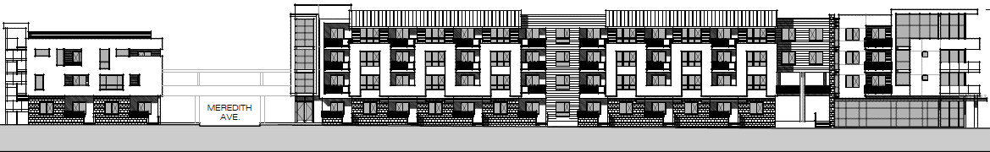
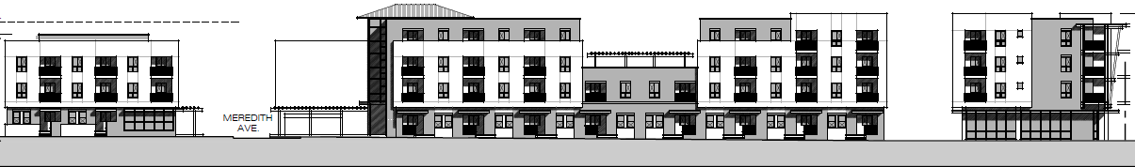
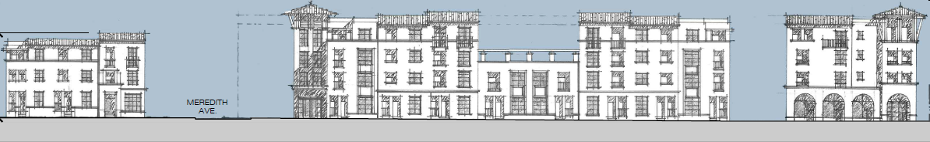
Design Iterations
PPR / Preliminary Consultation Submittal
Conditional Use Permit Submittal
Latest Design Iteration

Slide 21
1727-1787 East Walnut Avenue and
235 North Allen Avenue
Predevelopment Plan Review
City Council Meeting
May 20, 2013

