Slide 1
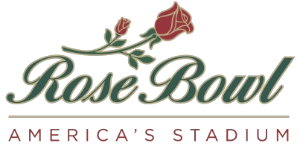
Project Update
City Council Meeting
May 20, 2013
ROSE BOWL RENOVATION AND IMPROVEMENT PROJECT

Slide 2
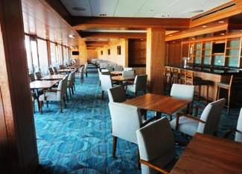
Project Update
Pavilion Substantial Completion; April 15
Premium seating sales: $5.3 million
2

Slide 3
Project Update
  Work in progress
    West side restrooms
    North electrical substation
    Broadcast building
    Permanent broadcast cabling
    Pavilion signage
3

Slide 4
Project Update
  Local Hire Efforts
    226 Pasadena Residents hired on the project
    $2,182,827 has been paid to residents (10.4%)
    $9,808,499 has been paid to local vendors through
    local subcontracting, local vendors, and local procurement
4

Slide 5
Description of Sources | Funds Available as of 4/24/13 | Anticipated Funds through 2013 | Anticipated Funds through 2018
2010 Bond Proceeds | 126.1 M
2010 BCS Revenue (RBOC) | 2.0 M
2006/2010 BCS (TOR) | 4.0 M
RBOC/IMG Retained Earnings | 1.1 M
Capital User Fee (TOR) | 1.6 M
2013 Bond Restructure Proceeds | 30.0 M
2010 Bond Interest |  | 0.4 M ¹
Concessionaire Investment |  | 2.0 M
2014 BCS Revenue |  |  | 3.4 M ²
Brick Campaign |  |  | 2.0 M ³
Legacy Contribution |  | 2.0 M | 7.0 M
Totals | $164.8 M | $169.2 M | $181.6 M
5

Slide 6
Updated Estimated Project Costs through 2014 (in millions)
Refer Project Uses of Funds dated 4/24/13;
(Prior Attachment C- Project Sources dated 12/31/12 has been included for reference)
Description | Awarded/Committed Costs + Estimated Costs 2014
Awarded/Committed Cost through Dec 2013 | 156.6 M
Estimated Direct Construction Cost (estimated to occur in 2014) | 9.02 M
Estimated Indirect Construction Costs (estimated to occur in 2014) | 1.1 M
Estimated Soft Costs, including FFE (estimated to occur in 2014) | 1.47 M
Sub-total through Dec 2014 | $168.8 M
Estimated Future Work (pending funding) | $12.7 M
Estimated Project Total through Dec 2018 | $181.5 M
6

Slide 7
Project Update
2014 Work and Implementation
    Field work for exiting purposes
    Restrooms field level
    Gate A improvements
    Bio-swale
    South end electrical substation
    Meter consolidation
7

Slide 8
Project Update
Remaining project elements (2015-2018)
    Upgrade 7 remaining gates
    Expand course area
    Increase concessions points of sale
    Transfer 17KV electrical service to existing structures
8

Slide 9
Legacy Update
ROSE BOWL RENOVATION AND IMPROVEMENT PROJECT

Slide 10
Legacy Update
Primary purpose to raise funds for Rose Bowl renovation project
Operating agreement with City & RBOC; Delegates to RBOC the authority to manage the naming rights
Tonight RBOC is requesting:
  Overall approval to name all inventory within fence line
    Will return to Council if field naming is seriously considered
  Provide Legacy opportunity to name Parkway & Area H
  Conceptual approval for Donor Plaza and Court of Champions
10

Slide 11
Legacy Update
15 Current Board members
Legacy pledges approx. $10 million to date
  7 year pledge period
  $2 million for project by the end of 2013
Legacy goal: $20 million (net)
  Terry Donahue pavilion
  Stadium Naming opportunities
  Court of Champions
  Public Campaign–Donor Plaza
  Areas leading into stadium – Parkway & Area H
11

Slide 12
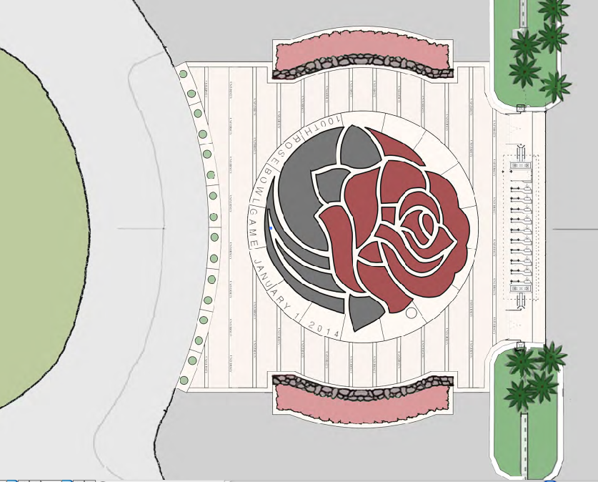
Public Campaign – Donor Plaza
12

Slide 13
Court of Champions
13

Slide 15
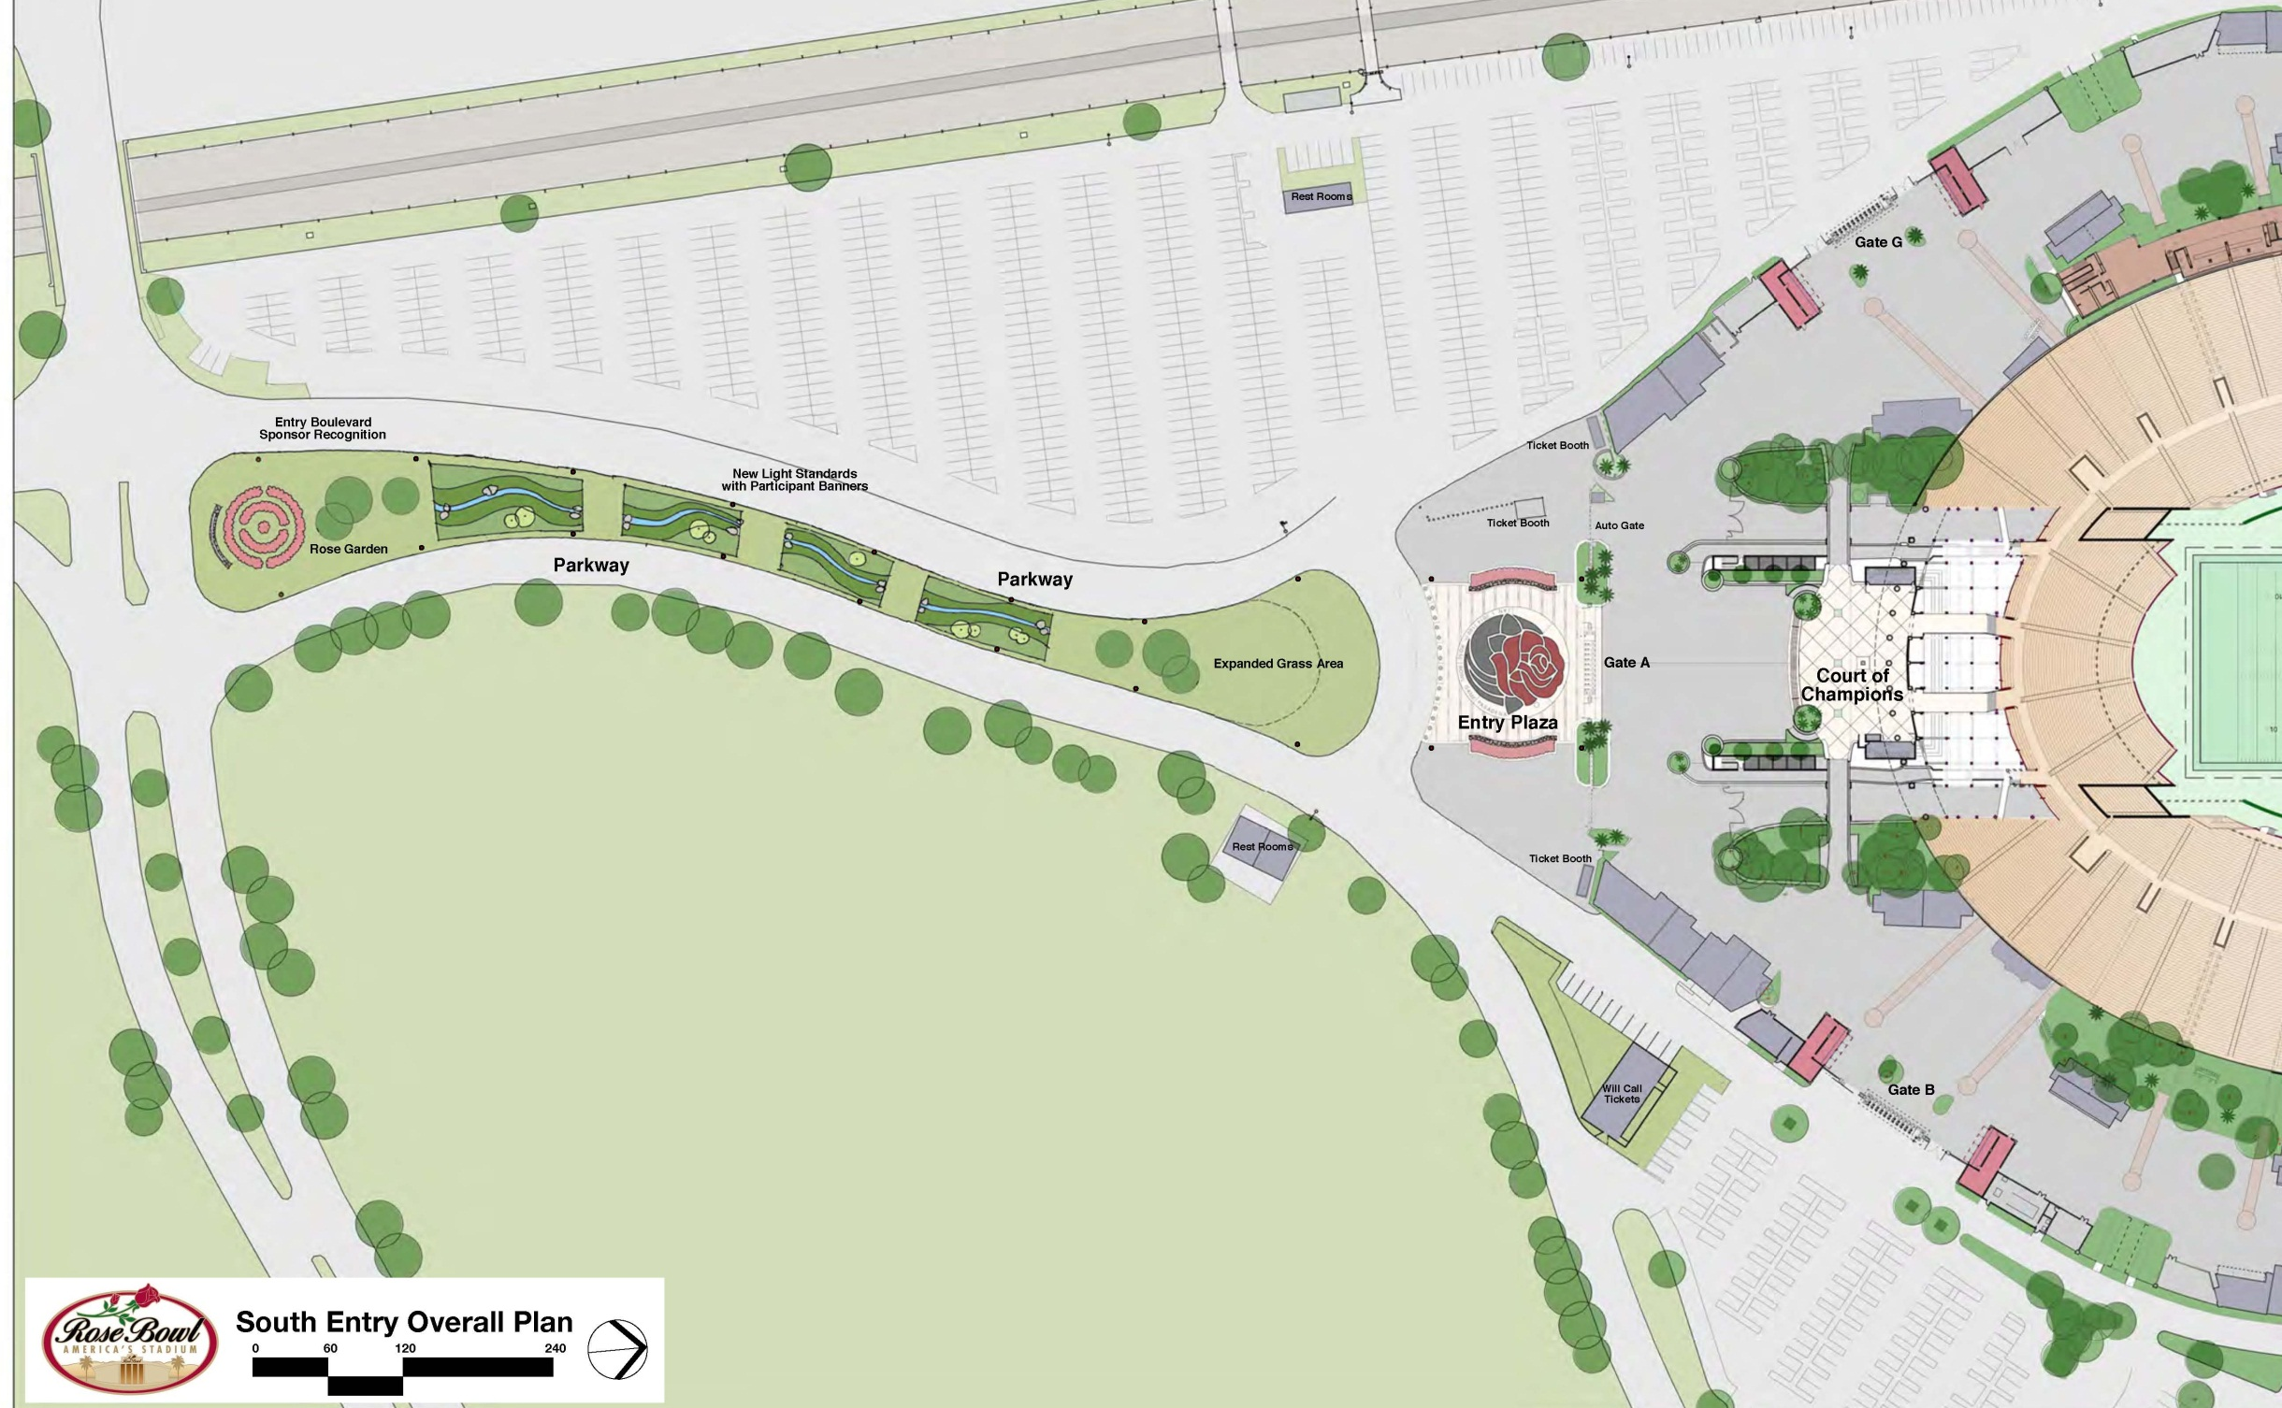
PARKWAY
AREA H

