Slide 1
Call for Review:
Expressive Use Permit #6052 and Associated Variance
City Council
May 20, 2013

Slide 2
Call for Review
Call for Review of Hearing Officer decision.
  City Council initiated a Call for Review of Expressive Use Permit #6052, modification of Conditional Use Permit #5465, and two Variances.
  City Council will consider:
    Expressive Use Permit #6052
    Variance (separation between uses in AD-1 overlay district)
  Board of Zoning Appeals considered (May 15, 2013):
    Conditional Use Permit #5465 (modification)
    Variance (separation between uses in AD-1 overlay district)

Slide 3
Call for Review
Call for Review is processed as an appeal.
Effect of Call for Review “vacates” the previous decision.
Call for Review/Appeal hearing is a de novo hearing.
  City Council has authority to make an entirely different decision.

Slide 4
Hearing Officer: April 3, 2013
Hearing Officer action:
  Expressive Use Permit #6052 (customer dancing, nightclub)
    Disapproved
  Variance #1 (separation, nightclub with alcohol sales)
    Disapproved

Slide 5
Hearing Officer: April 3, 2013
Hearing Officer action:
  Conditional Use Permit #5465 (modification)
    Approved 2 of 5 modification requests
      Hours of alcohol sales (1:00 a.m.); and
      Display of alcohol in refrigerator case (limited to 50% of display area / only accessed by employees).
    Disapproved 3 of 5 modification requests
      Charge entry fees;
      Customized lighting & sound system; and
      Sale of alcohol for off-site consumption.
  Variance #2 (separation, sale of alcohol for off-site consumption)
    Disapproved

Slide 6
Board of Zoning Appeals: May 15, 2013
Variance (separation, sale of alcohol for off-site consumption)
  Unanimous vote
  Upheld disapproval of Variance application.

Slide 7
Board of Zoning Appeals: May 15, 2013
Conditional Use Permit #5465 (modification)
  Unanimous votes
  Upheld the disapproval of one modification request:
    Sell alcohol for off-site consumption.
  Upheld the disapproval of two modification requests (withdrawn by applicant):
    Charge entry fees and customized lighting & sound system.
  Approved two modification requests:
    Hours of alcohol sales.
      12:00 a.m., Sunday-Thursday, 2:00 a.m., Friday & Saturday.
    Display of alcohol in refrigerator case.
      Limited to 75% of display area and only accessed by employees.

Slide 8
Existing Entitlement
Conditional Use Permit #5465 (February 2011)
  To allow Alcohol Sales -- Full Alcohol (beer, wine, and distilled spirits) for on-site consumption in conjunction with the operation of an existing restaurant (New York Deli).
  Approved by Hearing Officer
  Conditions of Approval were included to ensure the establishment would operate as a restaurant and does not transform into a nightclub or similar use.
    No cover charges or entry fees.
    No specialized lighting or sound system.
    No promoter-produced parties or events.

Slide 9
Code Compliance Investigation
Code Compliance investigation (July 2012)
  Initiated by a complaint from the Pasadena Police Department.
  Code Compliance staff issued a Notice of Violation (July 27, 2012).

Slide 10
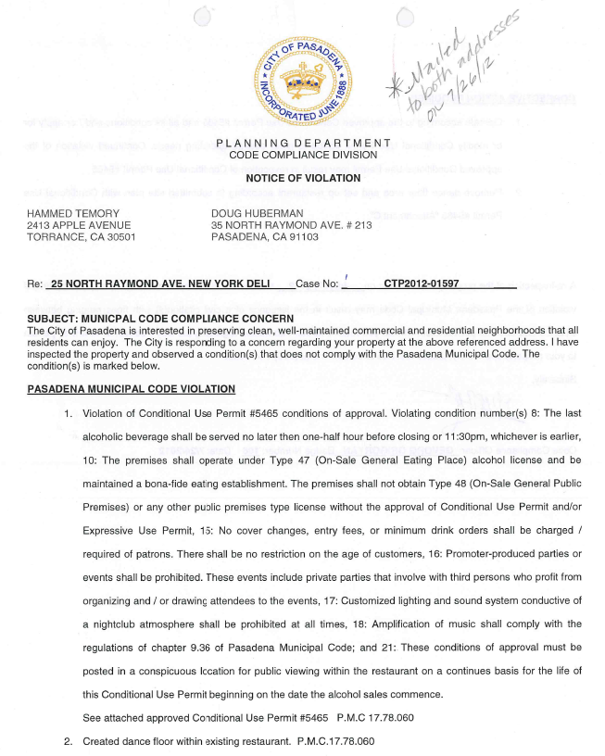
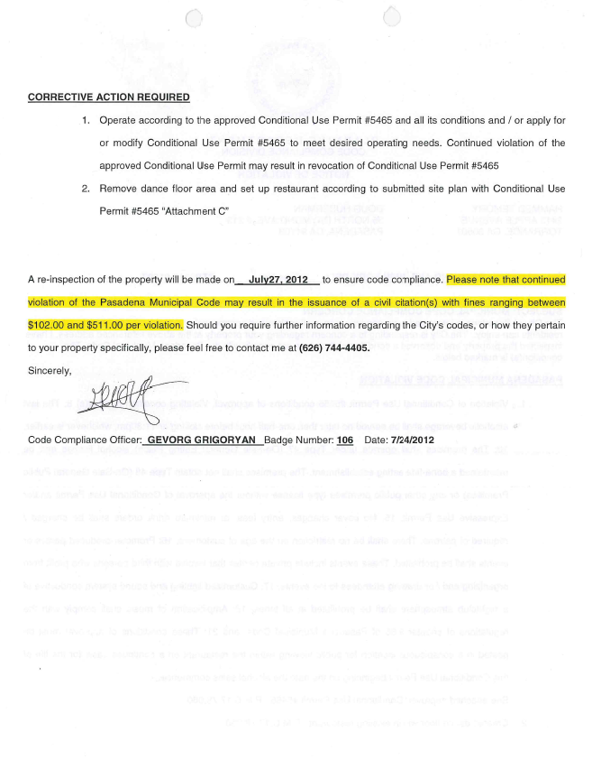
Code Compliance Investigation

Slide 11
Code Compliance Investigation
Code Compliance investigation (July 2012)
  Notice of Violation based on violations of conditions:
    #8 (selling alcohol past 11:30 p.m.);
    #10 (full food service not provided);
    #15 (only allowing entry to customers 21 and over);
    #16 (promoter-produced parties);
    #17 (customized lighting and sound system conducive of nightclub atmosphere);
    #18 (violating City’s Noise Ordinance); and
    #21 (did not have conditions of approval posted or available).

Slide 12
Background
Code Compliance investigation (July 2012)
  Additional violations:
    Dance floor for customer dancing
    Customer dancing is not permitted in restaurants per the Zoning Code definition of ‘Restaurants with Limited Live Entertainment’:
      “A restaurant, including a fast food or formula restaurant, that provides accessory live entertainment, where the performance area does not exceed 75 square feet, and customer dancing does not occur. The use shall be classified as a nightclub (commercial entertainment) if the performance area exceeds 75 square feet or customer dancing is provided. Live entertainment does not include a sexually oriented business.” (emphasis added)

Slide 13
Code Compliance Investigation
Subsequent investigations:
  August 2012
    Continued violations (citation issued).
  September and October 2012
    Continued violations (additional citations issued).
  November 2012 to present
    Determined to be in compliance with CUP.

Slide 14
Code Compliance Investigation
Operator of New York Deli met with City staff and discussed options.
Operator chose to modify Conditional Use Permit and submit a new Expressive Use Permit.

Slide 15
Proposed Entitlements: Variance (separation)
Variance
  To establish a nightclub with alcohol service within 250 feet of an existing bar or tavern, billiard parlor with alcohol service, nightclub with alcohol service, or use which provide sales of alcohol for off-site consumption within the AD-1 (Alcohol Density overlay, 1) district.

Slide 16
Proposed Entitlements: Variance (separation)
Alcohol Density (AD) zoning overlay
  Established by City Council in 1995.
    “…to control the possibility of an over-concentration of bars or taverns, billiard parlors with alcohol service, nightclubs with alcohol service and businesses which provide for the sale of alcohol for off-site consumption.”
      City Council staff report, 2/27/95
  Separation between new and existing bars or taverns, billiard parlors with alcohol service, nightclubs with alcohol service, or uses that sell alcohol for off-site consumption.
    AD-1: 250 feet
    AD-2: 1,000 feet

Slide 17
Proposed Entitlements: Variance (separation)
Alcohol Density (AD) zoning overlay
  Established by City Council in 1995.
    “If the proposed use cannot meet the distance requirement, then the applicant will have to seek a variance from this requirement. Variances are more difficult to approve and require finding that there are exceptional or unusual circumstances to the site and that the site is unique from other sites in the same zoning district.”
      City Council staff report, 2/27/95

Slide 18
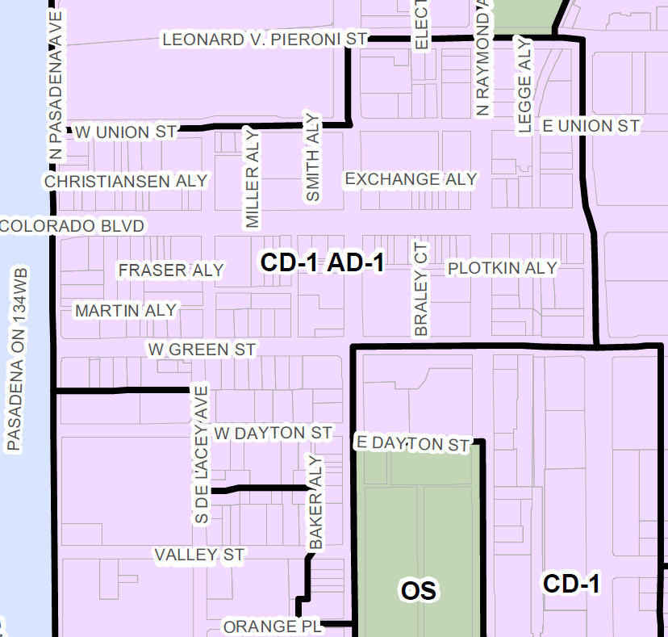
Proposed Entitlements: Variance (separation)
Alcohol Density-1 (AD-1) zoning overlay district.

Slide 19
Proposed Entitlements: Variance (separation)
Submittal of application for new:
  Bar or tavern;
  Billiard parlor with alcohol service;
  Nightclub with alcohol service; or
  Use that sell alcohol for off-site consumption
City staff first conducts a record search:
  Conditional Use Permits & Expressive Use Permits
    Any such uses currently exist within 250-foot radius?
  If none are found, staff will canvas the vicinity of the project site to determine whether any such uses exist.
    Some businesses pre-date the AD overlay.

Slide 20
Measurement Method
City’s Geographic Information System (GIS), “iMap” is used to measure between sites for Zoning Code compliance
  Separation between Child-Day Care sites, mailing notification, Neighborhood Compatibility analysis, etc.
Accuracy
  Study of accuracy of 2011 aerial photo was, “Tested to 0.7433 feet horizontal accuracy at 95% confidence level.”

Slide 21
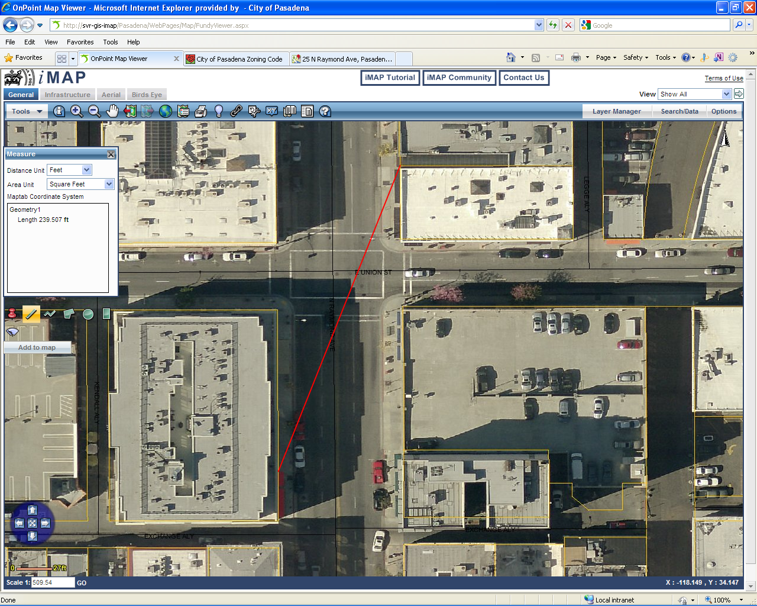
Separation Distance: Vertical Wine Bistro
Length 239.507 ft

Slide 22
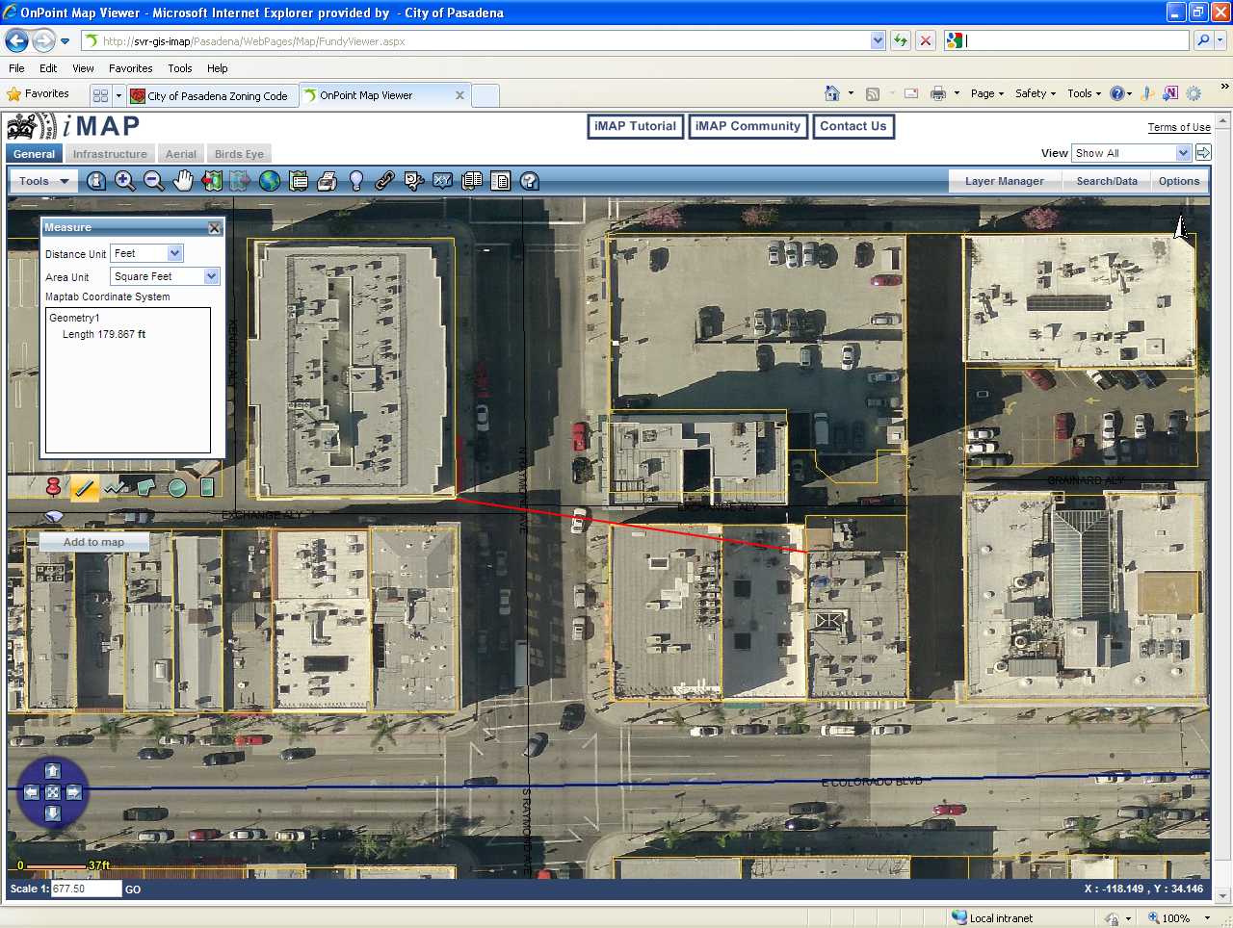
Separation Distance: Barney’s Beanery
Length 179.867 ft

Slide 23
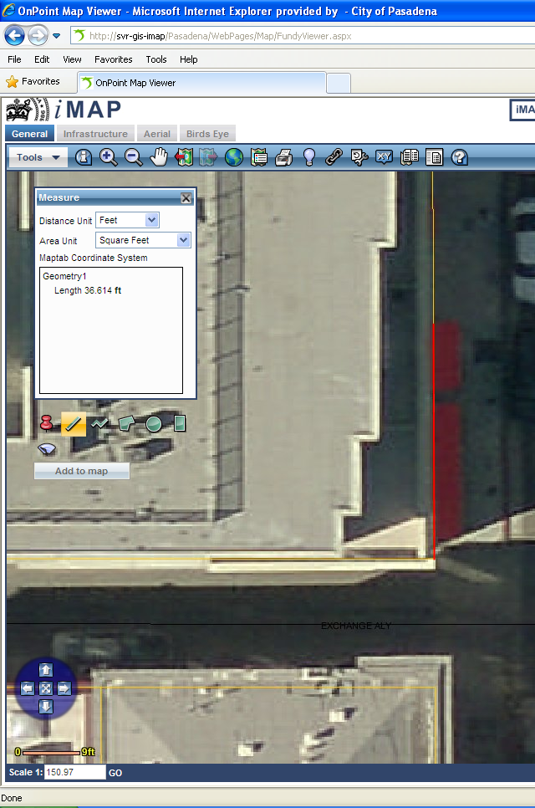
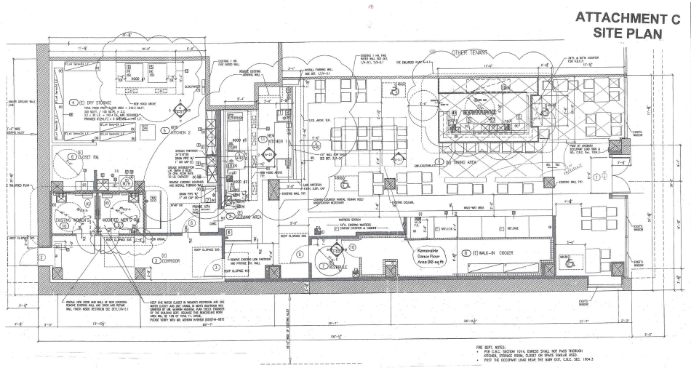
Measurement Comparison
36’-2”
36.614 feet

Slide 24
Proposed Entitlements: Variance (separation)
Vertical Wine Bistro (70 N. Raymond Ave.):
  240 feet away
  Conditional Use Permit (2005, 2006, 2007, 2008) and Expressive Use Permit (2007)
    Bar/tavern with customer dancing
    Sale of alcohol for off-site consumption.
Barney’s Beanery (99 E. Colorado Blvd.):
  180 feet away
  Conditional Use Permit (1991)
    Billiard parlor with alcohol sales.
    Pre-dates the AD overlay amendments.
Variance required.

Slide 25
Proposed Entitlements: Variance (separation)
Five Variance Findings:
  There are exceptional or extraordinary circumstances or conditions applicable to the subject site that do not apply generally to sites in the same zoning district;
  Granting the application is necessary for the preservation and enjoyment of a substantial property right of the applicant and to prevent unreasonable property loss or unnecessary hardship;
  Granting the application would not be detrimental or injurious to property or improvements in the vicinity of the subject site, or to the public health, safety, or general welfare;

Slide 26
Proposed Entitlements: Variance (separation)
Five Variance Findings:
  Granting the application is in conformance with the goals, policies, and objectives of the General Plan, and the purpose and intent of any applicable specific plan and the purposes of this Zoning Code, and would not constitute a grant of special privilege inconsistent with limitations on other properties in the vicinity and in the same zone district; and
  Cost to the applicant of strict compliance with a regulation shall not be the primary reason for granting the Variance.

Slide 27
Proposed Entitlements: Variance (separation)
This site does not have any exceptional or extraordinary circumstances or conditions:
  Regular-shaped property;
  Multi-story building;
  Multi-tenant building;
  Retail/restaurant on ground floor, housing above;
  Street/sidewalk frontage;
  Accessed by pedestrians; and
  Bounded by an alley on at least one side.

Slide 28
Proposed Entitlements: Expressive Use Permit
Expressive Use Permit #6052
  To establish a "nightclub" through the installation of a 96 square foot removable dance floor for use on holidays, Fridays, and Saturdays from 9:00 p.m. to 2:00 a.m.
    Zoning Code: ‘Restaurants with Limited Live Entertainment’:
      “A restaurant, including a fast food or formula restaurant, that provides accessory live entertainment, where the performance area does not exceed 75 square feet, and customer dancing does not occur. The use shall be classified as a nightclub (commercial entertainment) if the performance area exceeds 75 square feet or customer dancing is provided. Live entertainment does not include a sexually oriented business.” (emphasis added)

Slide 29
Proposed Entitlements: Expressive Use Permit
Five Expressive Use Permit Findings:
  The proposed use is allowed with an Expressive Use Permit within the subject zoning district and complies with the applicable development and design requirements of the subject zoning district and with all applicable provisions of this Zoning Code.
  The proposed use will provide and maintain wastewater to establish and maintain an unrestricted flow in sanitary sewers during average and peak conditions as established by the city's approved sewer master plan, as amended from time to time.

Slide 30
Proposed Entitlements: Expressive Use Permit
Five Expressive Use Permit Findings:
  The proposed use will provide and maintain solid waste services to establish and maintain a level of service consistent with the city's approved source reduction and recycling element.
  The proposed use will provide and maintain fire prevention and suppression services as established by the Uniform Fire Code to establish and maintain minimum response time for fire and emergency medical calls as established by the city's approved general plan.

Slide 31
Proposed Entitlements: Expressive Use Permit
Five Expressive Use Permit Findings:
  The proposed use will provide and maintain police services and crime prevention services to establish and maintain minimum response time for police calls for service as established by the city's approved general plan.

Slide 32
Proposed Entitlements: Expressive Use Permit
Finding #1 (Zoning Code compliance):
  Request requires a Variance.
    Variance findings cannot be made.
  EUP finding cannot be made.
Finding #5 (Police services)
  Pasadena Police Department Memorandum (2/25/13):
    “…not in agreement with the proposed modifications.” This is based on, “…concerns affecting our daily operations as well as community safety.”
  EUP finding cannot be made.

Slide 33
Recommendation
Uphold the Hearing Officer’s decision:
  Expressive Use Permit #6052:
    Disapprove request to establish a nightclub (commercial entertainment)
      Installation a 96 square foot removable dance floor for customer dancing for use on holidays, Fridays, and Saturdays from 9:00 p.m. to 2:00 a.m.
  Variance (separation):
    Disapprove request to establish a nightclub with alcohol service within 250 feet of an existing bar or tavern, billiard parlor with alcohol service, nightclub with alcohol service, or use that sells alcohol for off-site consumption.

Slide 34
Call for Review:
Expressive Use Permit #6052 and Associated Variance
City Council
May 20, 2013

Slide 35
Floor Plan
Proposed
Dance Floor
Raymond Ave.
Refrigerator Case

Slide 36
Pandora on Green
Pandora on Green, 33-45 E. Green St.
  Expressive Use Permit #5433, approved by Hearing Officer, June 16, 2010.
    Expressive Use Permit: live entertainment at restaurant and banquet facility; and
    Conditional Use Permit: alcohol at restaurant and banquet facility.
      Conditions to ensure it does not become a nightclub.
        Hours of alcohol sales: 10:00 a.m. to 1:30 a.m.;
        Restaurant to be open and have food service during all hours of operation;
        No signs advertising private parties;
        No customized lighting or sound systems conducive of nightclub;
        No cover charge or entry fees or age restrictions; and
        Sound study required.

