Slide 1
Amend Contract 20,023 with OPower for One Year Extension of
Home Energy Reports
City Council
Item 9
July 15, 2013

Slide 2
Background
Council Adopted Energy Efficiency Goals
  ~1% of retail sales each year
  Consistent with environmental goals, state policy
FY2014 Efficiency Funding is Limited
  Public Benefit Charge revenues
  Increasing solar, low income, and overhead expenditures
  Home Energy Reports (HERS) – low-cost option – staff recommended three year program extension
MSC Concerns
  Durability / validity of savings
  Making HERS available to all customers in future
  Moved to recommend a one-year extension through 6/2014

Slide 3
Home Energy Reporting Services
HERS is Provided to 11 California Utilities (15 Million Customers in 85 Utilities Nationwide)
Home Energy Reports Mailed to Recipients
Customer Website with Additional Analysis and Recommendations
Customer Service Interface for Support And Organizational Knowledge
Measurement and Verification
Notes:
Opower is providing the HERS to 11 utilities in California, and 15 million customers in over 80 utilities nationwide.
Paper reports are mailed every two months; recipients can opt to receive digital reports via email, as well as see their usage and recommendations on Opower’s web portal.
The interactive features of the web portal allows participants to:
Set a commitment to reduce their electric usage;
Track their progress towards their commitment, comparing their past 12 months of energy bills;
Conduct a self-evaluation of how they are currently using electricity;
Learn from a library full of efficiency recommendations
Opower’s methodology and results have been sanctioned by the California Energy Commission and verified by independent third parties.

Slide 4
HERS Pilot Phase
Pilot Program from June 2011 to July 2013
Behavioral Science and Analytics Used to Engage Consumers, Impact Their Energy Use
Participating Accounts “Treatment Group”
  Mix of 25,000 single-family and multi-family accounts
  Covers all energy usage levels and demographics
  Higher percentages for high usage and SFR
Non-Participating Accounts
  Function as “Control Group” benchmark
  Same energy usage and demographics as Participants
Notes:
In 2009, Council authorized a 2-year contract with Positive Energy (now renamed Opower), for a pilot electric efficiency program.
The program design uses behavioral science principles, parcel and customer energy use data, and complex methodology to display energy use to end users and compare their usage with similar households.
25,000 residential electric customers were randomly selected to receive 4 printed reports, delivered in the mail, each year. (“treatment” group)
15,000 similar customers were selected to compare the usage of the other group, and see if the information in the reports would result in behavior that would reduced their energy use. (“control” group)
The first reports were delivered in June 2011.

Slide 5
HERS Features / Benefits
Reaches 25,000 Residential Customers Annually
  Marketing and outreach opportunity
  Balance of programs reach less than 1,000 customers per year
Applies “Social Norming” to Motivate Conservation
Customers Think About Energy Use
Lowest “First Year” Program Cost 8-9¢/kWh
Large Energy Savings Results
  Could contribute about 27% of FY2014 savings
  ~$250K/year reduced energy, fuel, CO2, transmission costs
  Long-run benefits could exceed $400K per year
Notes:
Discuss how the “social norming” approach works, and is different from a usage graph or audit.

Slide 6
Proposed Extension
Refill Treatment Group to ~25,000
Prepare and Mail 4 HERS Per Customer
Web Portal Access for All Residential Customers
Customer Engagement Survey
Continue Savings Measurement & Verification
Assess Options to Deliver HERS to All Residential Customers Starting FY2015

Slide 7
FY2014 Efficiency Programs
Annual Energy Efficiency Savings | Projected Cost
Notes:
The first year results of the pilot program were lower than originally predicted when this was first proposed in 2009 (___MWh); likely due to the effects of the Great Recession and the resulting lower energy used by all customers. Typical experience among Opower’s clients.
The results PWP and the participating customers received are very cost-effective, compared to rebate programs that are offered to all “Other Residential” customers.
The HERS delivered over 2,200 MWh of energy savings in its first year, or 1.6% of all energy used by the customers analyzed in the program. These 1.6% savings results have been verified by Navigant.

Slide 8
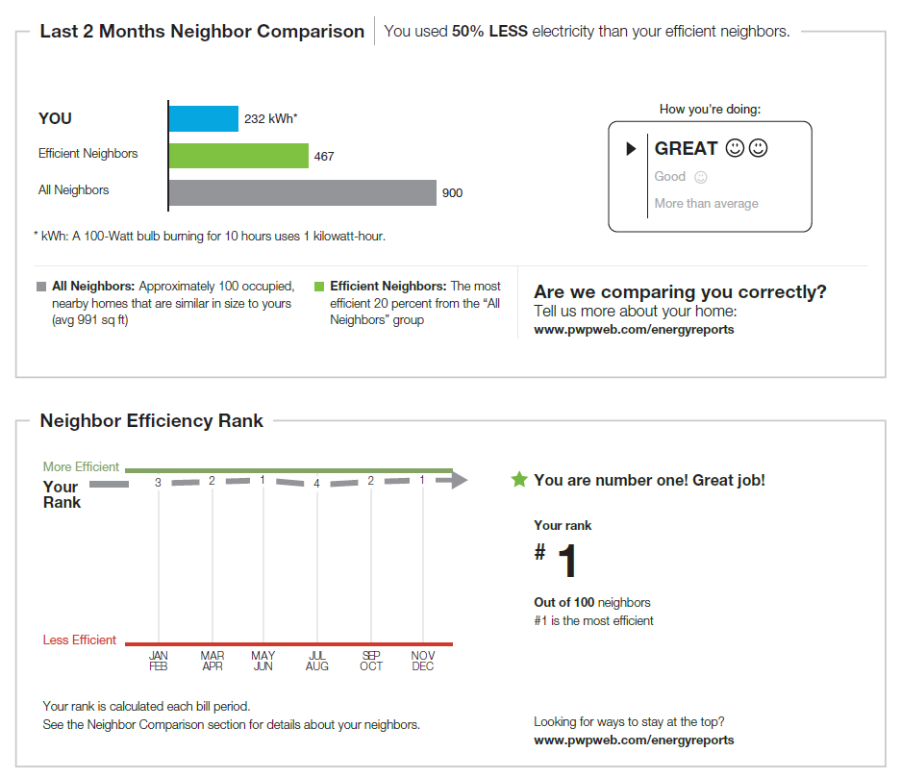
Summary Comparisons
Notes:
Next 6 slides are screen shots of what participants receive and see online – do you want to see these, or move along to the program results?
Example of the comparison and ranking of the end user with similar end users.
When people see there are others who are doing better than they are, the typical reaction is an interest in learning how to make changes tht will bring the individual closer to or better than their peers.

Slide 9
Monthly Detail
Notes:
Participants can see how their electric use is trending over time, and the financial impacts of reducing their usage.
More specific information, such as the square footage of the home, can be updated by the user on the web portal, thus increasing the validity of the data OPower collects from the county assessor's office.

Slide 10
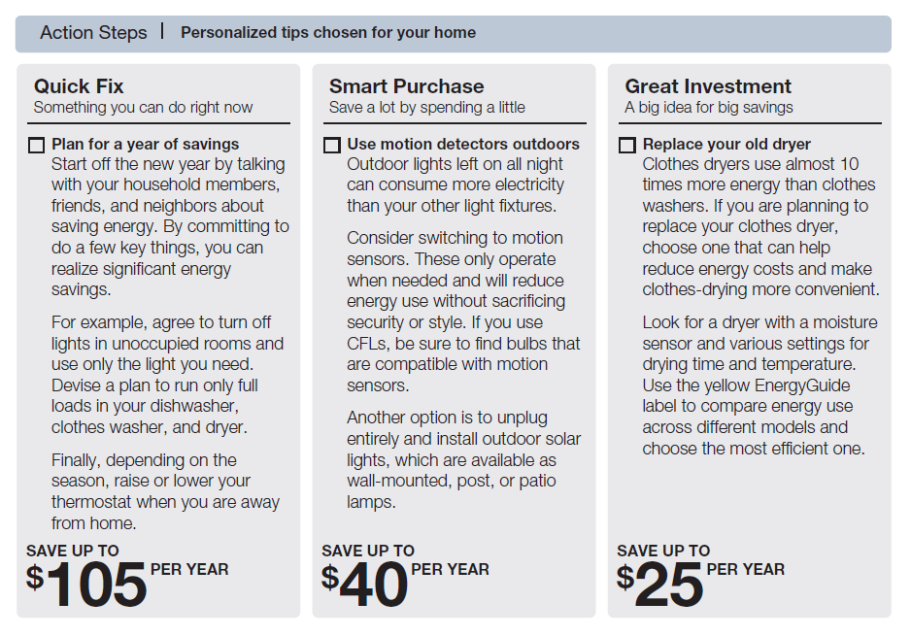
Actionable Recommendations
Notes:
The reports provide actionable efficiency tips, ranging from little or no cost to more costly investments.
Users not only find ways to save energy, but also information on the rebates and other special programs PWP has to offer.

Slide 11
Cost and Value
Notes:
Valuation assumes the following average avoided cost figures:
Short-Run – 8¢ (annual: 7, 8, 9¢)
Long-Run – 12.5¢ (annual: 12, 12.5, 13¢)

Slide 12
Alternative Programs
Program Option | Results for $309,000 Budget |  |  |  | Req’d Budget to Achieve 3,496,000 kWh
 | Units Installed | Customers Reached | Net Annual kWh Savings | Net Lifecycle kWh Savings
OPower HERS, 4 per year | 100,000 | 25,000 | 3,496,000 | 5,244,000 | $309,000
LED Coupon, 3 per customer* | 30,900 | 10,300 | 1,545,000 | 23,175,000 | $699,000
LED Distribution, 1 per customer* | 14,045 | 14,045 | 561,818 | 8,427,273 | $1,923,000
Refrigerator Exchange | 1,364 | 1,364 | 717,139 | 7,171,392 | $1,506,000
A/C Tune-up* | 1,315 | 1,315 | 315,574 | 3,155,745 | $3,423,000
Whole House Partnership* | 381 | 381 | 409,206 | 4,910,471 | $2,640,000

Slide 13
Alternative FY2014 Portfolios
 | w/o Home Energy Reports |  |  |  | With Home Energy Reports
Program Group | Cost ($000) | kWh (000’s) | % of kWh | $/kWh | Cost ($000) | kWh (000’s) | % of kWh | $/kWh
Home Energy Reports | --- | --- | --- | --- | 309 | 3,496 | 27% | 0.09
Other Residential | 1,061 | 2,080 | 16% | 0.51 | 961 | 1,579 | 12% | 0.61
Non-Residential | 2,707 | 10,670 | 84% | 0.25 | 2,108 | 7,674 | 60% | 0.27
Total | 3,768 | 12,750 | 100% | 0.30 | 3,378 | 12,750 | 100% | 0.26

Slide 14
Recommendation
Authorize contract amendment with OPower, Inc.
  Add $309,000; total amount not to exceed $927,000
  Provide 25,000 home energy use reports and web portal access to all residential electric customers for one additional year through June, 2014

Slide 15
Backup Slides

Slide 16
PWP’s Energy Efficiency Goals (MWh/year)

Slide 17
Energy Savings Potential for $309,000 Budget (MWh/year)

Slide 18
Cost to Achieve FY2014 HERS Energy Savings ($000)

Slide 19
Concerns
Customer Complaints
  Offensive / insulting
  Invalid comparisons
  Data security / privacy
  Waste of paper / money
Durability of Savings
HERS Distribution Choices
  Use of same treatment (recipient) group
  Send to all customers?
Direct Funds to Other PBC Programs

Slide 20
Achieving Efficiency Goals
Codes and Standards
Educational Programs
  Limited or no measureable and reportable savings
Encourage Efficient “End Use” Devices
  Direct install programs (no cost to customer)
  Incentive programs (rebates)
Behavioral Programs
  Audits / usage data (not highly effective/quantifiable)
  Comparative / social norming (HERS)

Slide 21
Annual PBC Expenditures ($000)

Slide 22
EE Program “First Year” Cost
Average energy efficiency program costs are fairly stable

Slide 23
Highest Potential for Efficiency
* From 2012 EE Potential model used to set 10-year goals
Notes:
In 2012, the City Council adopted EE goals for the next ten years. This required the use of a special model that was developed for California publicly-owned utilities.
Navigant, the consultant who developed the EERAM model for estimating the EE potential, produced a list of efficiency measures that could be useful to PWP residential customers in order for the utility to reach its cost-effective and feasible efficiency goals.
“Home Energy Reports” has the single largest potential for residential energy efficiency in Pasadena.
Measure Energy Savings Potential Demand Reduction Potential
Home Energy Report 13,263 0
Recycle Refrigerator 4,850 716
HVAC Quality Maintenance 4,631 4,258 = 22,744 MWh (64% of total measures recommended in EERAM)
Green Switch 3,088 0
CFL: 13W Indoor 1,591 226
CFL: 23W Outdoor 1,155 0
CFL Fixture Outdoor 1,136 0
CFL: 13W Outdoor 979 0
Smart Outlet Strip 763 48
CFL: 23W Indoor 758 118 = 13,041 MWh (36% of total measures recommended in EERAM)

Slide 24
Where Energy is Used
Notes:
This is what participants see when they visit the web portal, which includes graphic displays of where their energy is being used and tips for reducing usage.
Unique users = 1,401 logged in (@ 5% of base)
Looked at pages an average of 6.5 minutes each
10 page views per user (average)

Slide 25
Set A Personal Savings Goal
Notes:
Participants may set a goal to reduce their usage, and HERS will track this goal against the actual usage.

Slide 26
Tips for a Personal Savings Plan
Notes:
Once a goal is set, specific action items are reviewed which participants can select to see the effect towards reaching their goal.

Slide 27
FY2012 Results (Pilot Year 1)
Energy Efficiency Savings (MWh) | First Year Cost* (¢/kWh)
* Includes overhead costs
Notes:
The first year results of the pilot program were lower than originally predicted when this was first proposed in 2009 (___MWh); likely due to the effects of the Great Recession and the resulting lower energy used by all customers. Typical experience among Opower’s clients.
The results PWP and the participating customers received are very cost-effective, compared to rebate programs that are offered to all “Other Residential” customers.
The HERS delivered over 2,200 MWh of energy savings in its first year, or 1.6% of all energy used by the customers analyzed in the program. These 1.6% savings results have been verified by Navigant.

Slide 28
Monthly Energy Savings
Notes:
Energy savings have been steadily increasing since inception
1.6% savings from June 2011 to June 2012
2.6% expected this year (FY2013) (may reach 3,700 MWh)
May be stabilizing next 2 years at around 2.8% or 2.9% (4,000 MWh per year)

Slide 29
Participant Comments
Comments received since June 2011 = 316 (1.3%)
  255 Phone calls and 61 e-mails
  139 have opted out completely
“Who are my neighbors I am compared with? They have more people and have lower bills. I don’t trust this comparison!”
  Opower uses complex algorithms; selects customers with similar energy use, building and demographic characteristics
“Why is this mailed separately from my bill? This is a complete waste of money!”
  PWP’s billing system cannot do the complex analytics nor add this much information to existing bill
“How secure is my data? Invading my privacy!”
  Opower’s policies and protocols follow “Trust Principle Standards”
  SOC2 audit certified by Deloitte & Touche LLP
  Data is not shared with any other party or subcontractor.
Notes:
Staff have directly assisted 316 HERS participants since 2011 (1.3% of total receiving reports)
First response to callers = Have you updated your profile on web portal? This may result in a more accurate comparison with others.
Opting out always an option; 140 opted out since 2011, a minimal # for the participant group (6%; half the typical number seen with other utilities)
Staff assisted (113) customers over the phone to opt out of program
Staff assisted several to convert to electronic reports and reduce paper
Typical comments center around concerns over
Trust of methodology
Using separate mailing for reports, rather than adding this to regular bill
Security of data

Slide 30
Survey - Satisfaction
RKS Survey “How Useful is HERS” | PWP Web Survey “Overall Satisfaction on 0-10 scale”
Notes:
RKS asked participants (47% of responders) and non-participants (50% of responders) to rate their HERS report (or if they were to be provided a HERS report):
Participants:
Very Useful = 47%
Somewhat useful = 30%
Not too useful = 10
Not at all useful =10%
Non-participants:
Would be very useful = 39%
Would be somewhat useful = 41%
Would not be too useful = 9%
Would be not at all useful = 6%

Slide 31
Survey – Continue/Terminate
RKS Survey “Continue or Terminate HERS” | PWP Web Survey “HERS Should Be Extended ”
Notes:
RKS asked HERS participants whether PWP should “continue” or “terminate” the pilot program:
Extend = 72%
Terminate = 11%

Slide 32
HERS Contract Cost
Cost Component | FY2014 | FY2015 | FY2016 | Total
Set up and configuration | $25,000 |  |  | $25,000
Other one-time fees | $65,000 |  |  | $65,000
Recurring services | $159,000 | $159,000 | $159,000 | $477,000
Printing and mailing | $60,000 | $60,000 | $60,000 | $180,000
Total Base Contract | $309,000 | $219,000 | $219,000 | $747,000
Optional services |  | $25,000 | $25,000 | $50,000
Postage contingency |  | $10,000 | $15,000 | $25,000
Total Not To Exceed Amount | $309,000 | $254,000 | $259,000 | $822,000
Notes:
"Set up and configuration" fee is for the refill work to bring our HERS treatment population back to 25,000 households and for the configuration work to make the web accessible to all your customers.
Refill needed as some customers who have moved away have been dropped
Energy Insider web access to up to 60,000 customer accounts
“Other” fees include Customer Engagement Tracker Survey and Report setup; 2 promotional modules (for marketing PWP programs and services).
CET will conduct a customer satisfaction survey of 1,000 HERS users in Year 3
Send 2 marketing pieces to 25,000 participants in Year 3
“Recurring Services” is the annual license fees.
“Printing and Mailing” of 4 reports per year to 25,000 households.
“Optional Services” may include additional surveys and other features not yet available.
“Postage Contingency” covers potential US Postal Service increase in postage rates.
Total contract not to exceed $822,000

Slide 33
HERS Program Cost
Notes:
Slightly higher again in year 3 with new web licenses for all, refill, survey and marketing pieces.

Slide 34
HERS First Year Savings Cost
Notes:
Cost of energy savings were higher in Year 1, with start up costs.

