Slide 1
Level 4 Water Supply Shortage Plan Public Hearing
Presented by
Gary Takara, Principal Engineer
City Council - Item #12
January 28, 2013

Slide 2
MWD 8-Day Shutdown
Metropolitan Water District of Southern California (MWD) is scheduling work at its facilities:
  From: Thursday, February 21, 2013
  To: Thursday, February 28, 2013
PWP purchases 60% of its water from MWD.
No water deliveries to Pasadena during the eight day shutdown.
Pasadena must rely solely on water stored in reservoirs and groundwater supplies.

Slide 3
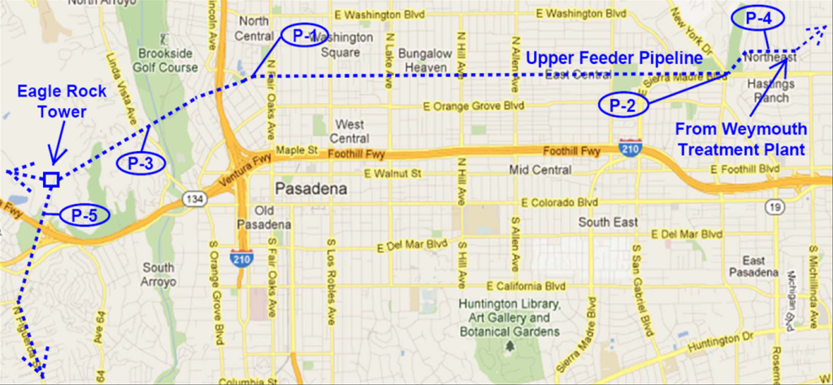
MWD Repair Work
Replacing valve actuators at Eagle Rock Tower.
Installing chemical ports at F.E. Weymouth Treatment Plant.
Repairing a joint in the Upper Feeder Pipeline.
A valve failure could disrupt water deliveries to over 17 cities.

Slide 4
Water Supply and Demand
Eight-Day Totals
Avg. Daily Supply (MGD)
175 MG supply:
  Reservoirs - 80 MG
  Five local wells - 95 MG
173 MG demand
No contingency reserves to address such as:
  Delay in completing MWD repairs and improvements
  Loss of groundwater wells
  Higher demands
  Large main break or significant fire event

Slide 5
Water Conservation
Thirty percent reduction in water use is necessary to ensure adequate supply margin
Prohibit outdoor watering
Implement Level 4 Water Supply Shortage Plan

Slide 6
Water Supply Shortage Plan Levels
Requirements | Level 1 | Level 2 | Level 3 | Level 4
Watering Days Per Week | 3 summer 1 winter | 2 summer 1 winter | 1 summer 1 winter | No watering or irrigating
Obligation to Fix Leaks, Breaks or Malfunctions | 72 hours after notification | 48 hours after notification | 36 hours after notification | 24 hours after notification
Additional Prohibitions | N/A | No filling ornamental lakes/ponds | No filling ornamental lakes/ponds | No filling ornamental lakes/ponds No filling residential pools/spas No new potable water service provided

Slide 7
Public Outreach
Press releases and paid advertising
News articles through City and PWP publications
Citywide direct mailer
Direct outreach to City Depts., large customers
Leverage community groups and Council Field Reps
Daily updates during shutdown on the City’s website, Facebook, and Twitter
Water shortage hotline (626) 744-8888
On the web: www.PWPweb.com/Shutdown

Slide 8
Recommended Action
Declare CEQA Exemption
Determine Water Supply Shortage Emergency Condition Exists During the MWD Shutdown
Determine Level 4 Water Supply Shortage Plan conservation measures are appropriate during the MWD Shutdown
Adopt Proclamation

