Slide 1
500 S. El Molino Avenue
Cornish Manor Court
Application for Landmark Designation
City Council
January 14, 2013

Slide 2
Project Summary
Property location – East side of S. El Molino Avenue, between East California and Del Mar Boulevards
Property is an intact example of a bungalow court
Application for landmark designation submitted by property owner
HPC recommended approval of the designation at its October 1, 2012 meeting

Slide 3
Recommendation & Effects
Staff recommendation: Approve designation of 500 S. El Molino Avenue as a landmark
Effects of landmark designation:
  Future protection of exterior features from inappropriate alteration or demolition
  Eligible to apply for Historic Property Contract (Mills Act)
  Eligible to use State Historical Building Code
  Potential variances from current Zoning requirements

Slide 4
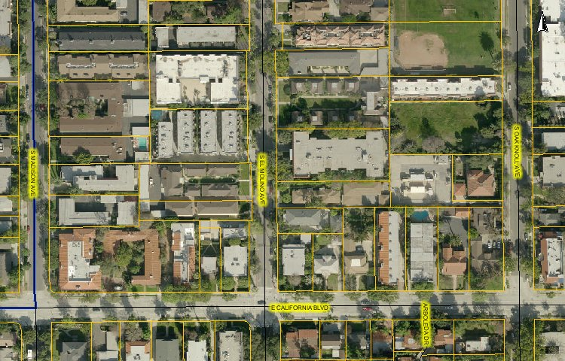
Site Location

Slide 5
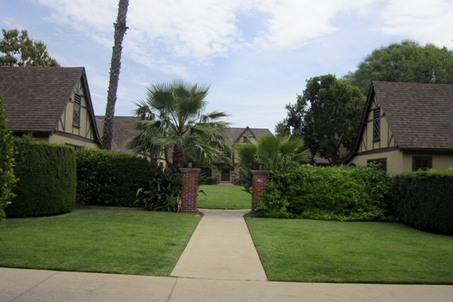
View of Site from El Molino Avenue

Slide 6
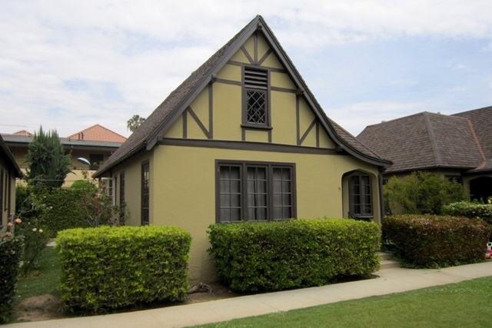
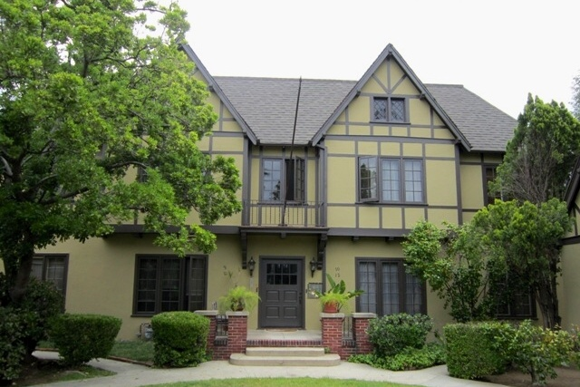
Typical Bungalow & Rear Fourplex

Slide 7

Questions?
Cornish Manor Court

