Slide 1
254 East Union Street
Pre Development Plan Review
City Council Meeting
February 25, 2013
Notes:
Pre-Development Review
Process established to achieve better projects through early consultation between City staff and applicants
Identify issues that may arise during application process
Plans routed to all City Departments for comments
Comments presented to applicant in mid-September
Project met the threshold to be presented to the City Council as an information item

Slide 2
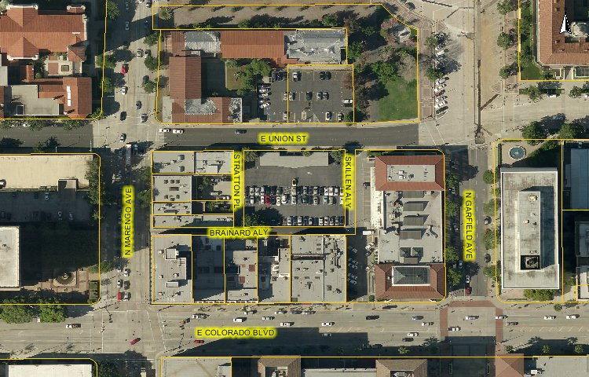
Property Location
City
Hall
YWCA
Post
Office
Notes:
Project site on S. Los Robles Ave. just south of Green Street.
Area of 18,600 sf.
Surrounding properties include:
Parking structure for the Paseo Mall to the north
A sister mixed-use project to the south that is currently under construction. To the south of that is the Livingston Hotel
Office building across the street to the east.
Project site is currently developed with two small buildings and surface parking.

Slide 3
Background
Zoning: CD-2 (Central District Specific Plan, Civic Center/Midtown Sub-district)
Existing use: Parking lot for 225 E. Colorado Blvd. building
Parcel size: 21,741 square feet (0.49 acres)
Pre Development Plan Review (PPR):
  Mixed Use Project (Three work/live units; 49 residential units)
City staff met with applicant on December 20, 2012
Notes:
Parking is underground – shared access with sister project to the south.
Height is the same as the sister project to the south.

Slide 4
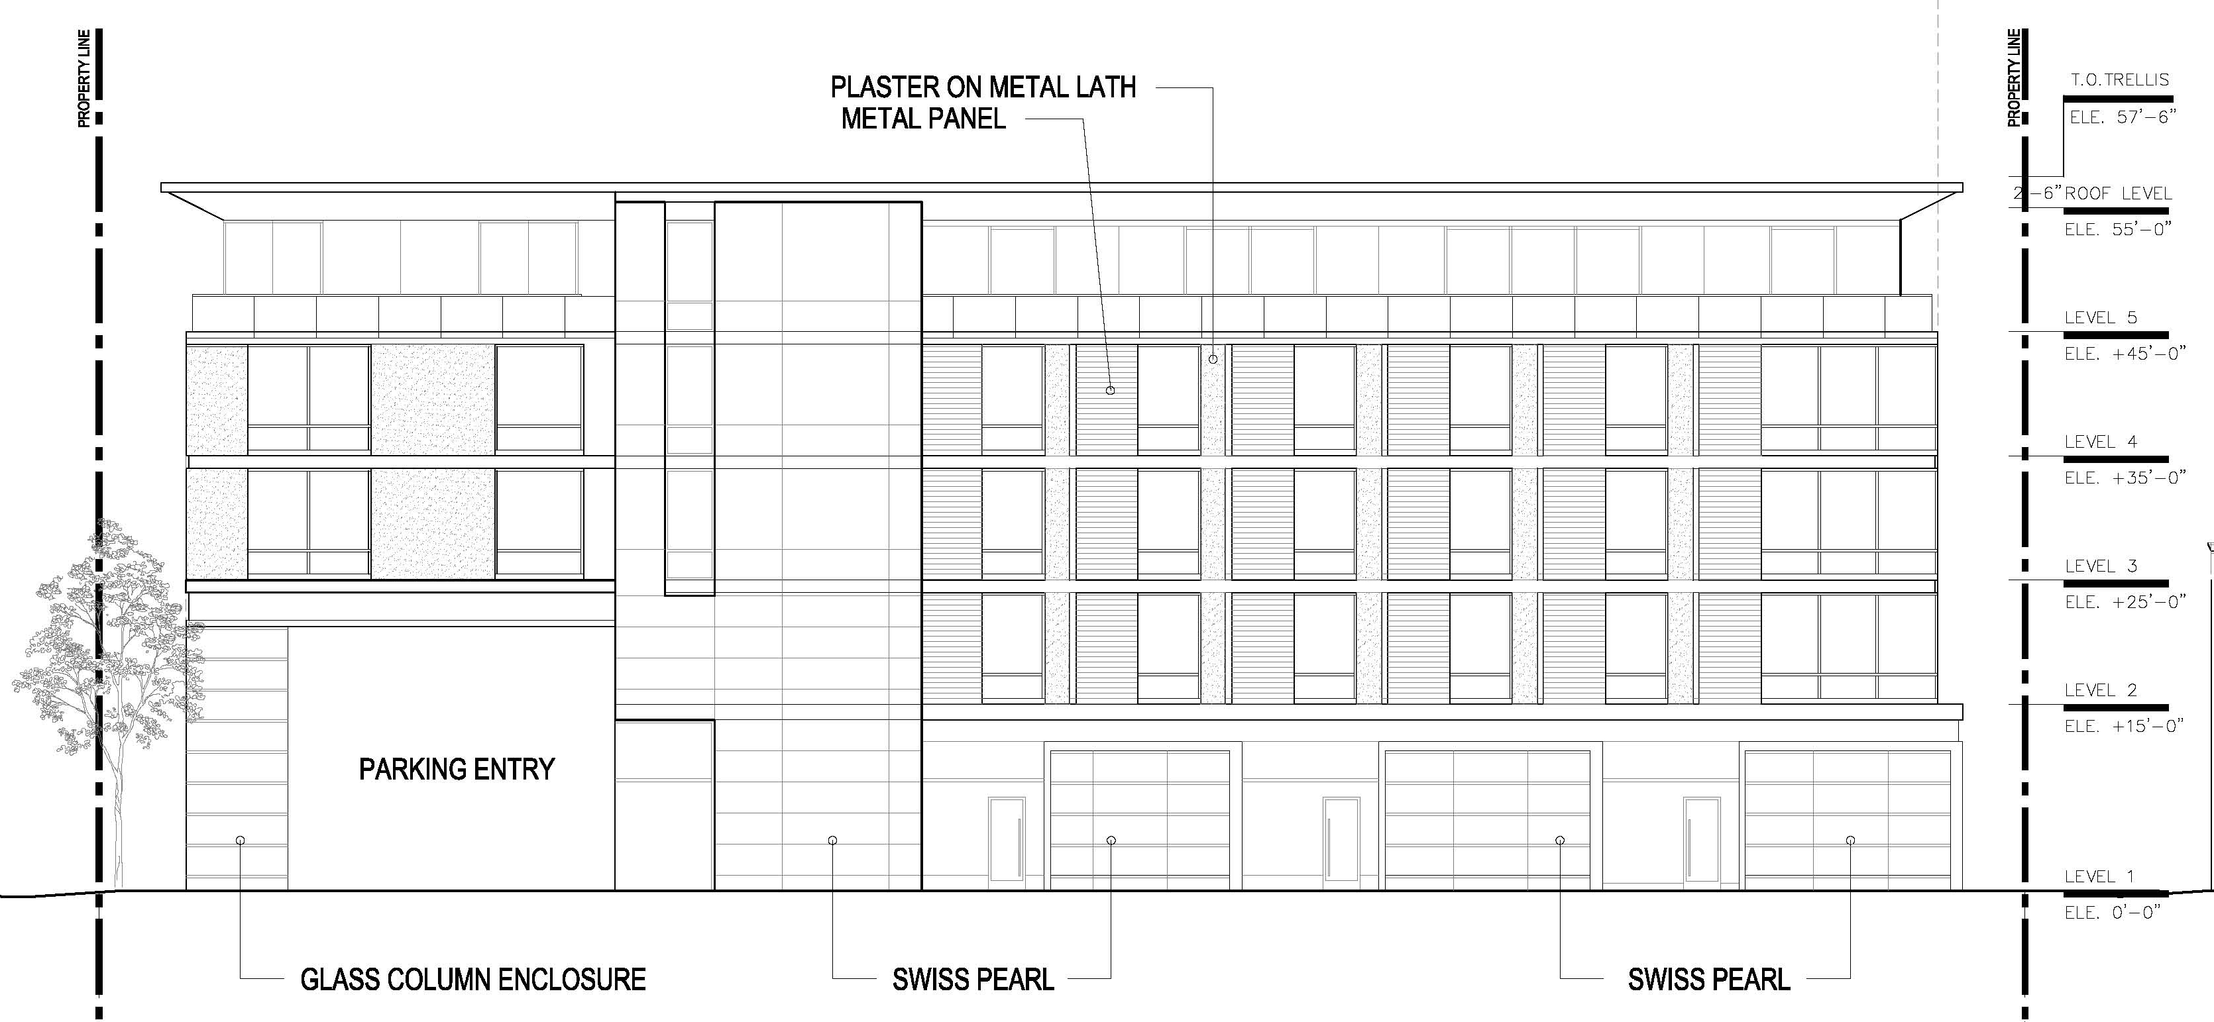
Union Street Elevation

Slide 5
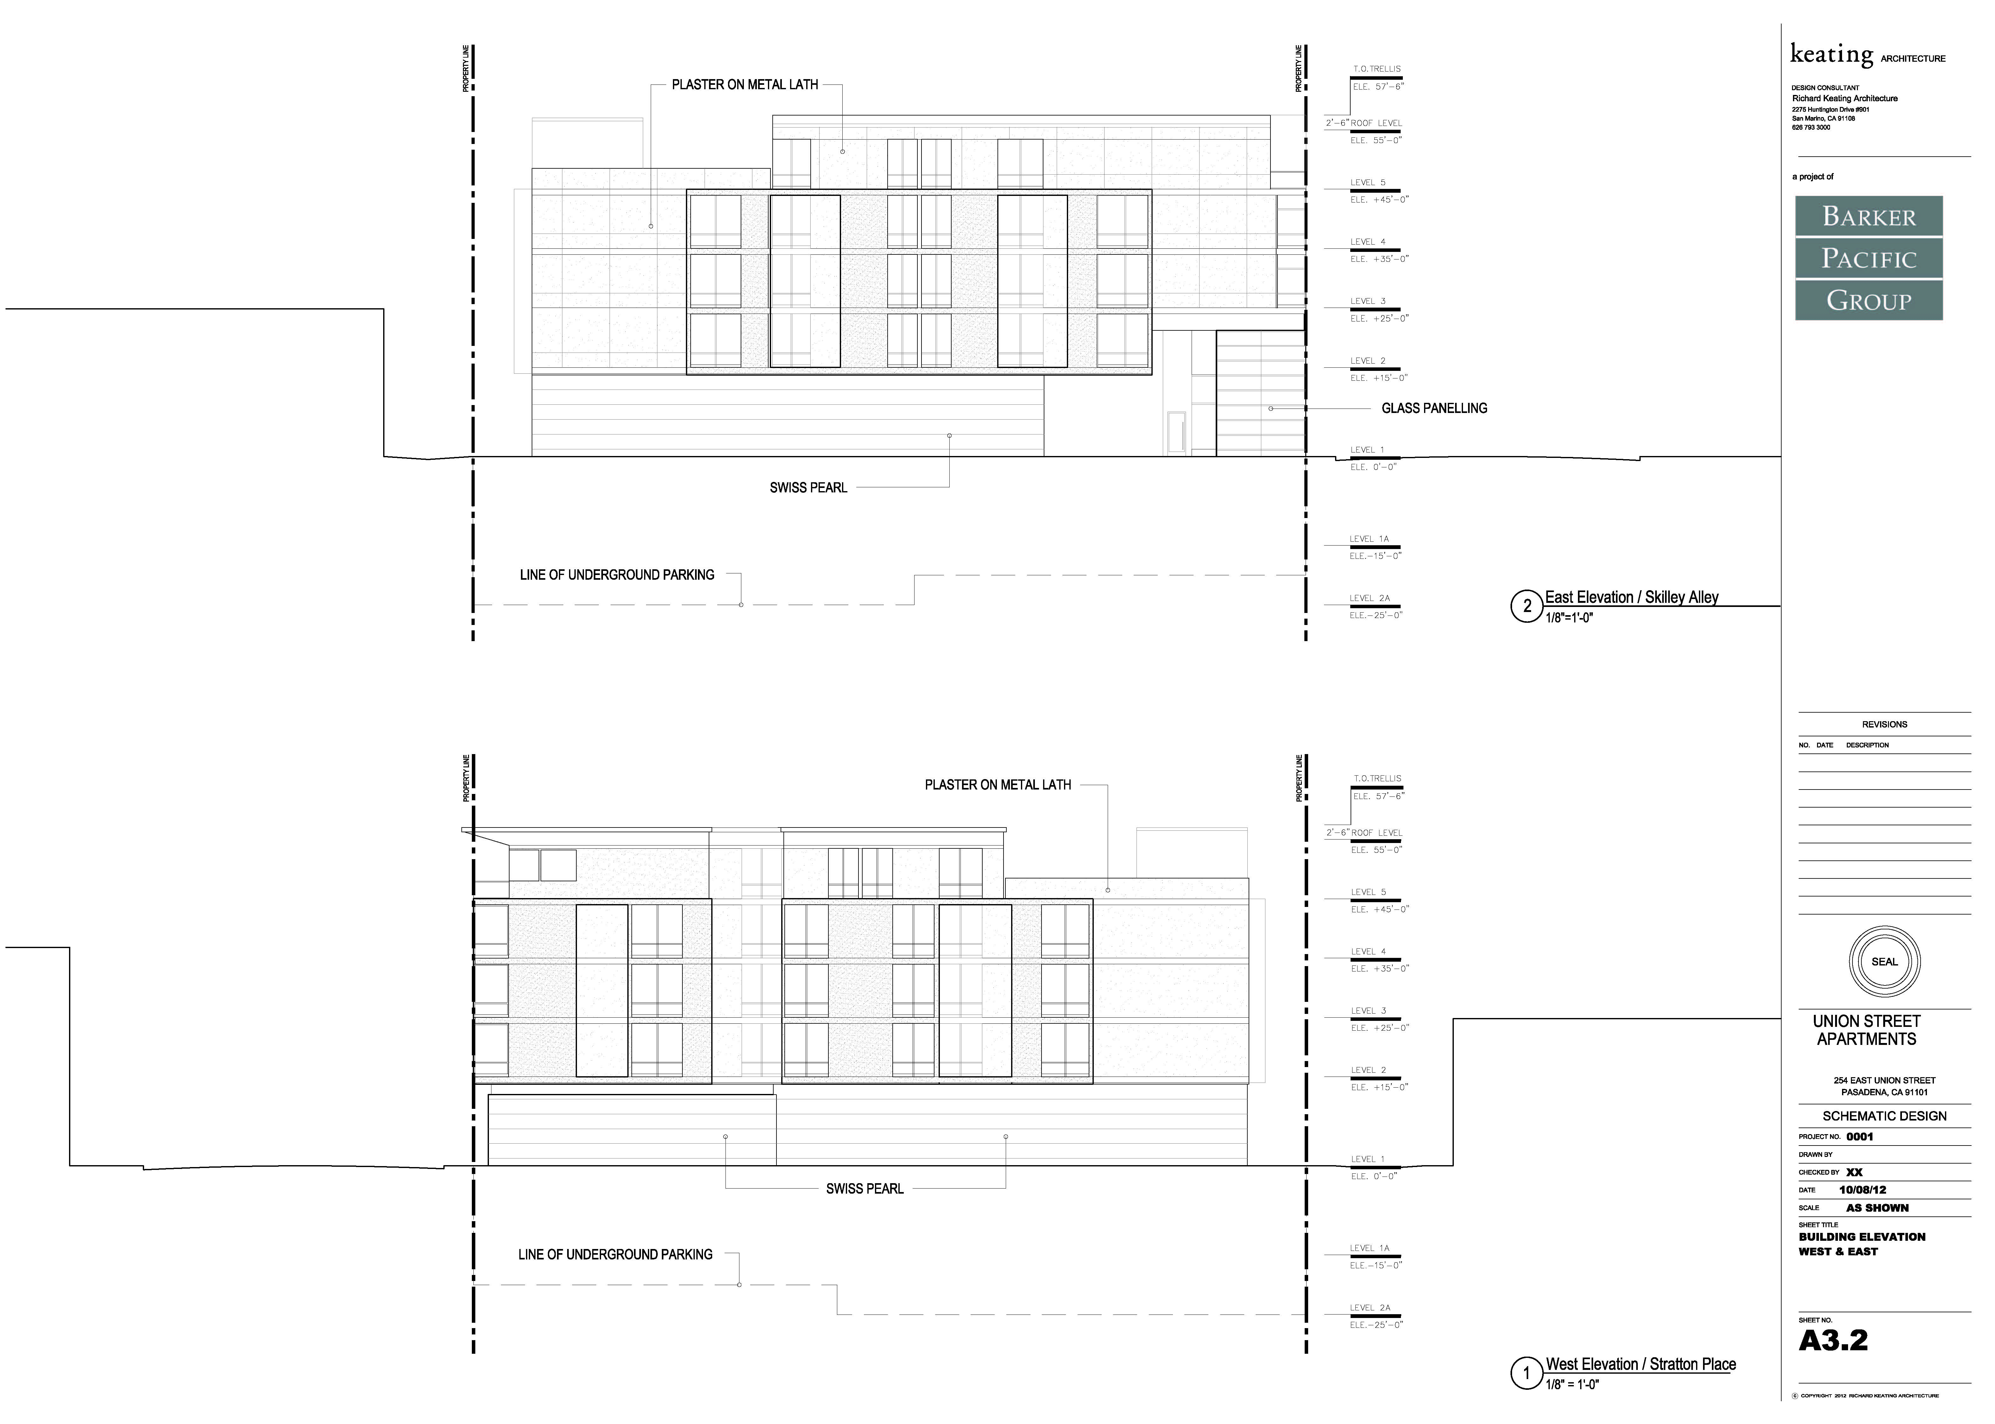
Skillen Alley Elevation (East Side)
Notes:
Top picture – street elevation
Bottom picture – side elevation

Slide 6
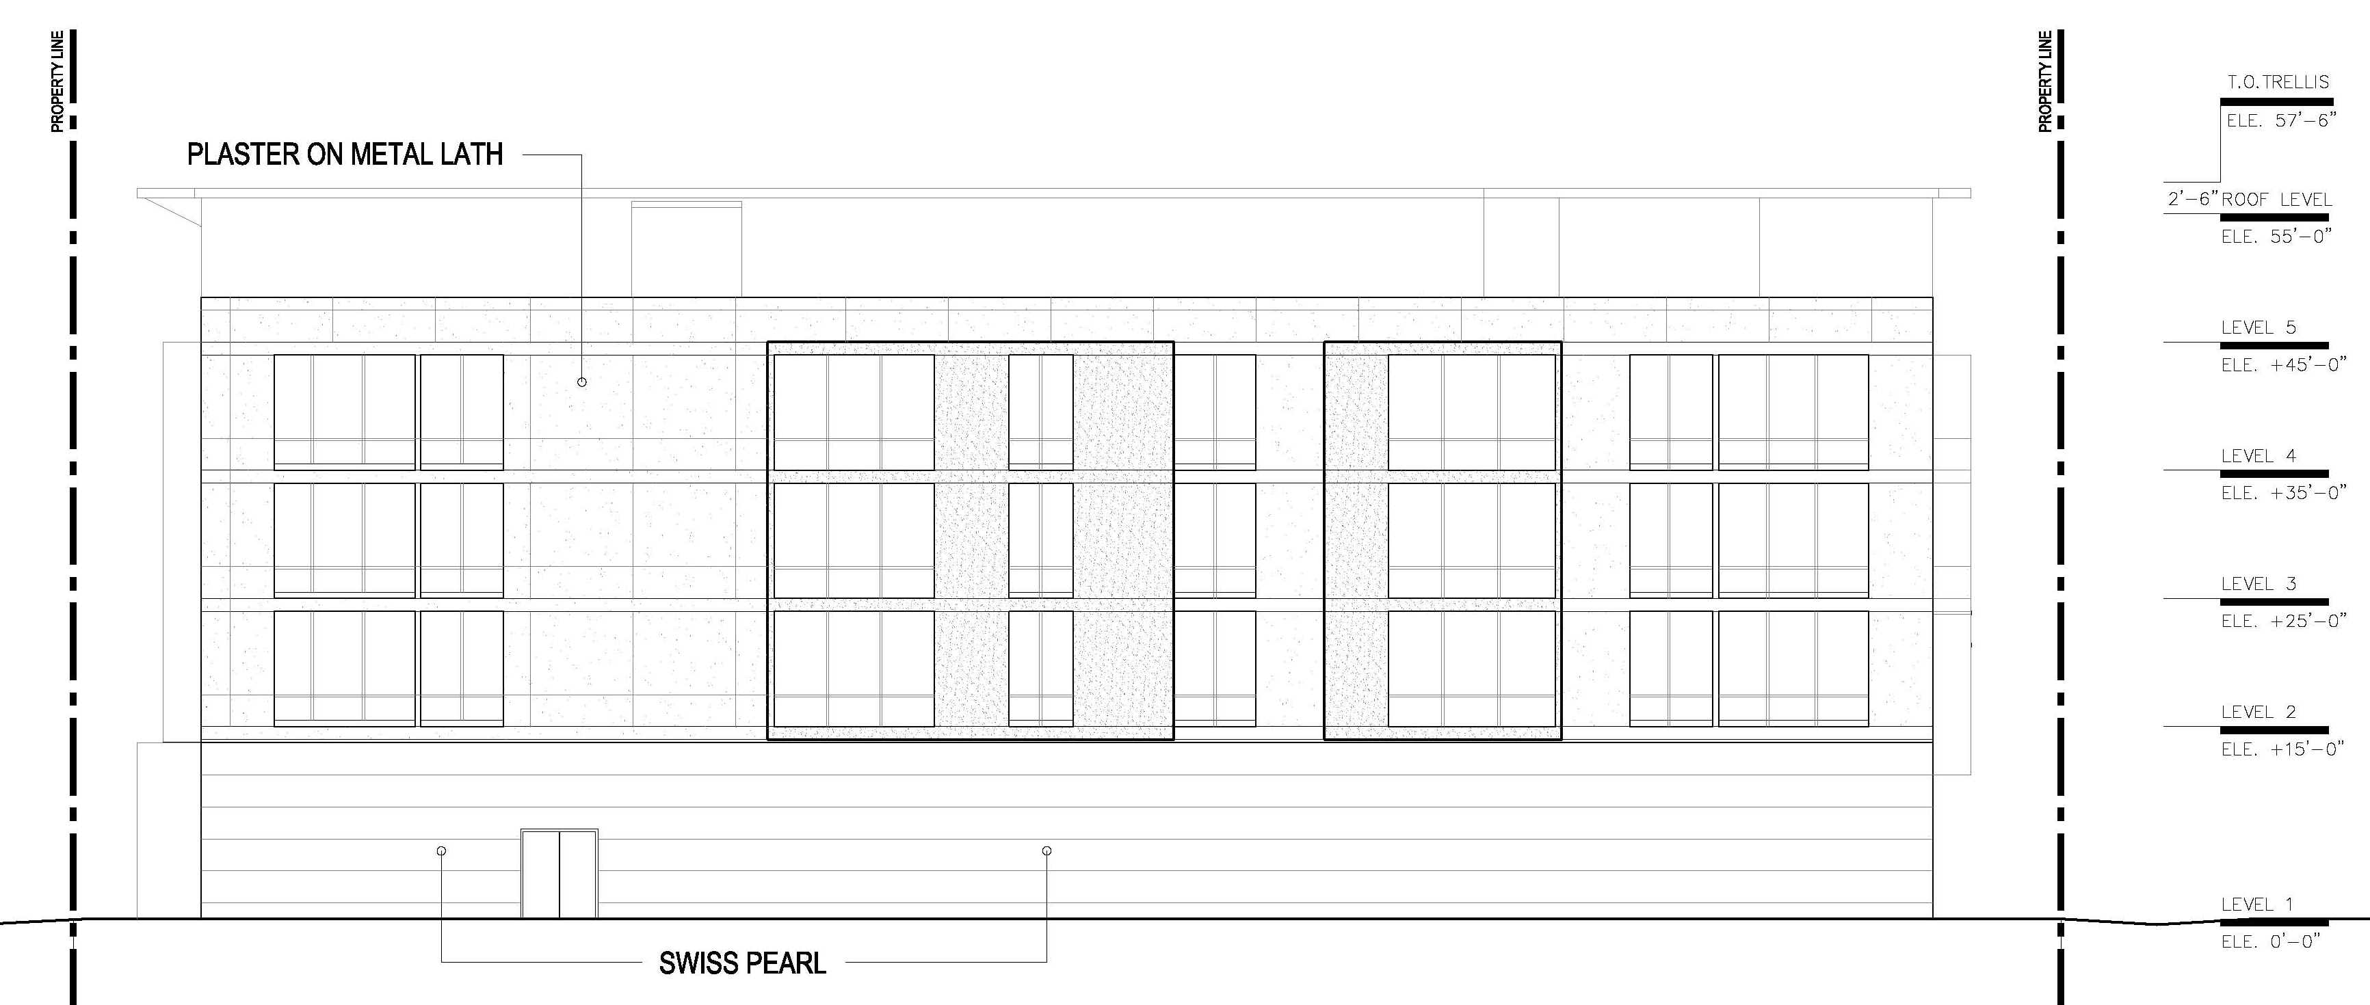
Brainard Alley Elevation (Rear)

Slide 7
Stratton Place Elevation (West Side)

Slide 8
Project Summary
Building will measure 42,241 square feet
Height – five stories, or 57 feet, 6 inches
(Specific Plan allows up to 60 feet)
Parking - Two subterranean levels, one semi-subterranean level and one above-ground level to accommodate 150 parking spaces (including 60 spaces to replace existing spaces for 225 E. Colorado Blvd.)
Four units will be affordable; density bonus requested
to exceed maximum allowable density of 43 units

Slide 9
Discretionary Entitlements
Minor CUP for non-residential tandem parking
Design review
Initial Study will be prepared to determine if an
EIR will be required
Notes:
Parking is underground – shared access with sister project to the south.
Height is the same as the sister project to the south.

Slide 10
Overall Comments
Through the PPR process, staff identified several key issues that will require additional analysis during the formal review process:
  The compatibility of the project with surrounding historic buildings and districts;
  Disposition of the historic sign on the property;
  Reconfiguration of the building’s vehicular access; and
  Compliance with density bonus requirements.

Slide 11
Planning Division Comments
Project Subject to Design Review
Issues that will be analyzed during the Design Review Process:
  Study ways to screen at-grade parking and circulation within the building from street view;
  On-site historic resource should be carefully integrated into project.
  Incorporate “inviting” pedestrian design features;
  Study massing, fenestration, storefront design and materials to respond to historic buildings in the vicinity; and
  Consider strategic placement of landscaping.
Notes:
Project follows the mixed-use standards of the Zoning Code.
Commercial tenant space on the ground floor is 2,600 sf.

Slide 12
Planning Division Comments
Central District Specific Plan:
  The project is located in the downtown area, thus focusing growth away from residential neighborhoods. The site is located within 1/4 mile of a light rail station;
  Project should strive to meet the Specific Plan objective that the distinctive character of Downtown and its unique Sub-districts be maintained and further enhanced and that new development respond to the area’s architectural heritage with sensitivity and offer creative design solutions.
  Cultural Affairs
  Public art will be required for the project

Slide 13
Comments from Other Departments
Transportation
  A traffic study will be required for the project
  Vehicular access should be moved to the alley
Public Works
  Dedications will be required on all four streets surrounding the property
  Construction of alley widening and corner cut-offs and installation of street lights and trees will be required

Slide 14
254 E. Union Street
Pre Development Plan Review
City Council Meeting
February 25, 2013
Notes:
Pre-Development Review
Process established to achieve better projects through early consultation between City staff and applicants
Identify issues that may arise during application process
Plans routed to all City Departments for comments
Comments presented to applicant in mid-September
Project met the threshold to be presented to the City Council as an information item

