Slide 1
Proposed Amendment to
PMC Chapter 2.75
(Historic Preservation Commission)
City Council Meeting
February 25, 2013
Notes:
Pre-Development Review
Process established to achieve better projects through early consultation between City staff and applicants
Identify issues that may arise during application process
Plans routed to all City Departments for comments
Comments presented to applicant in mid-September
Project met the threshold to be presented to the City Council as an information item

Slide 2
Background
PMC Chapter 2.75 creates Historic Preservation Commission
Section 2.75.030.B allows each landmark district to have a representative that participates in and votes on items within their district
City has both City landmark districts and, historic districts listed in the National Register
Chapter 2.75 does not provide for historic districts listed in the National Register to have a voting representative on the HPC
Notes:
Project site on S. Los Robles Ave. just south of Green Street.
Area of 18,600 sf.
Surrounding properties include:
Parking structure for the Paseo Mall to the north
A sister mixed-use project to the south that is currently under construction. To the south of that is the Livingston Hotel
Office building across the street to the east.
Project site is currently developed with two small buildings and surface parking.

Slide 3
Landmark/Historic District Comparison
Criteria for listing landmark/historic districts very similar
  Higher percentage of contributing properties required
Guidelines for projects in landmark/historic districts are the same
  Secretary of the Interior’s Standards
  City’s 2002 Design Guidelines for Historic Districts
Review procedures in landmark/historic districts are the same

Slide 4
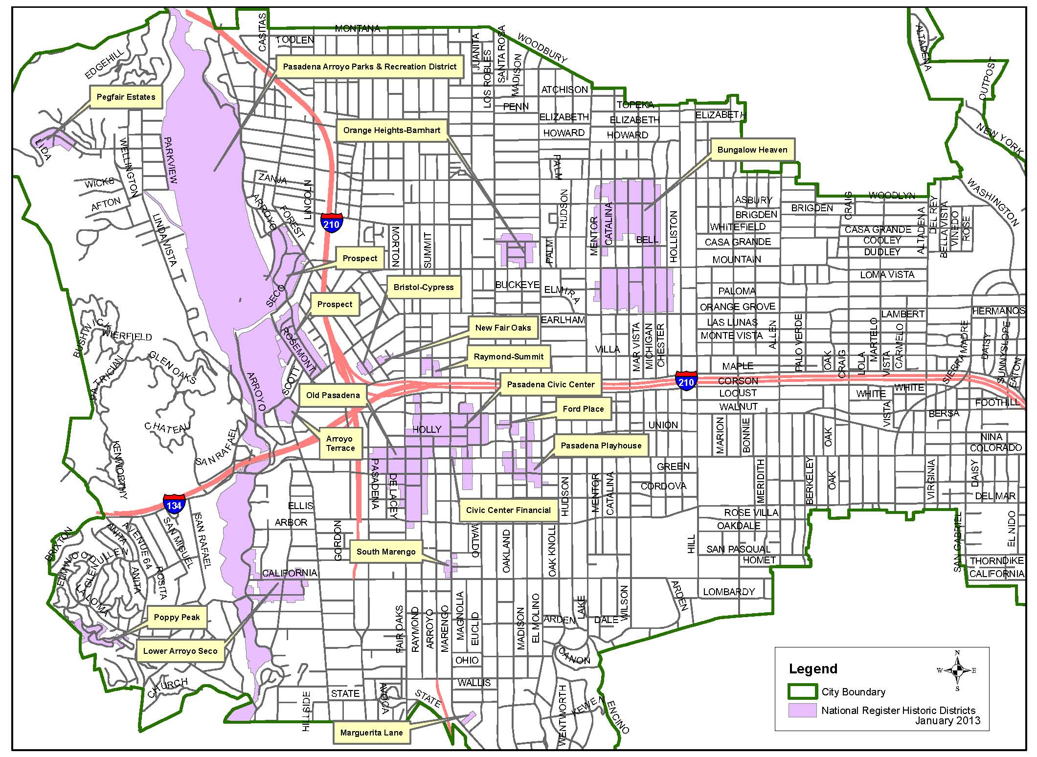
Map of National Register Historic Districts in Pasadena

Slide 5
Proposed Change
Modify Section 2.75.030.B to allow historic districts the same representation on the HPC as landmark districts
Representatives would not be Commissioners and would only participate and vote on items in their district, after which they would step down and the Commission would continue its meeting with its regular nine members
Notes:
Parking is underground – shared access with sister project to the south.
Height is the same as the sister project to the south.

Slide 6
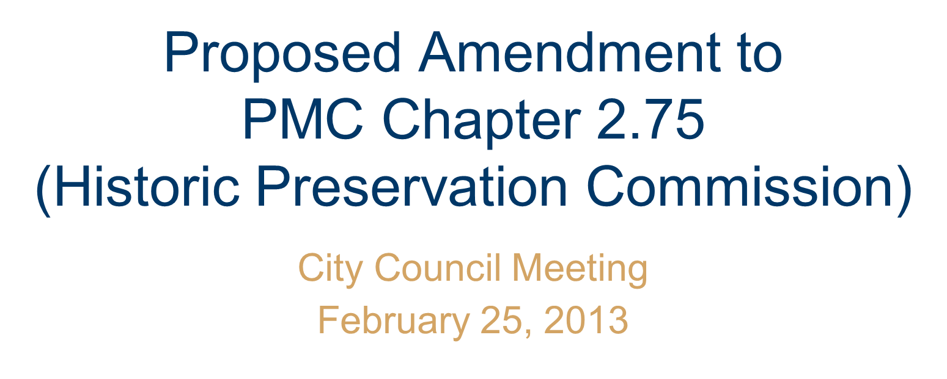
Questions?

