Slide 1
Transfer of the Human Services Endowment Fund
City Council
October 29, 2012
Valerie Babinski, Program Coordinator

Slide 2
Background
The HSEF was established in 1992
The fund consists of several bequests and other funds directed by Council
Annual expenditure not to be below $113,200
Only investment earnings to be expended
Awards from the fund are made annually and are incorporated into the CDBG funding process

Slide 3
Background
Fund value peaked in 2002 at approximately 2.6M
Investment earnings have been minimal while the expenditures have remained fairly consistent and in line with the established threshold

Slide 4
Current Status of the Fund
Current value is approximately $1.9M with and non-expendable floor of $1.8M
With the City’s investment policies growth will be minimal and would require indefinitely suspending giving from the Fund in FY 2014
To continue viability of the fund staff recommends a transfer of the Fund to the Pasadena Community Foundation

Slide 5
Fund Comparison FY 02-12
City Investment Fund Performance 2002-12
Beginning Balance (2002) $2.6M
Ending balance (2012) $1.9M
Loss of $584,000
Pasadena Community Foundation Estimates
Beginning Balance (2002) $2.6M
Ending Balance (2012) $2.88M
Growth of $277,500

Slide 6
Transfer of the Fund
Allow for greater investment
Ability to pursue other sources of income including donations
Will not affect the purpose of the funds, the method in which awards are made, or the recommending advisory body
Will involve risk that may impact the funds overall earnings
Predicts higher growth rate and increase oversight of the amount available to allocate annually

Slide 7
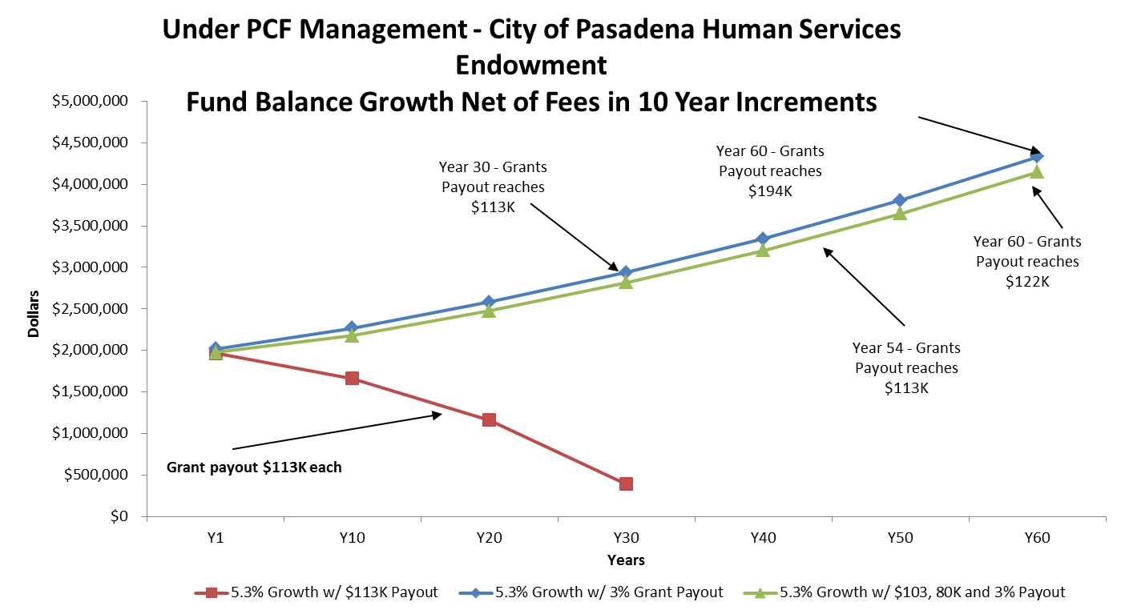
60 Year Fund Projection

Slide 8
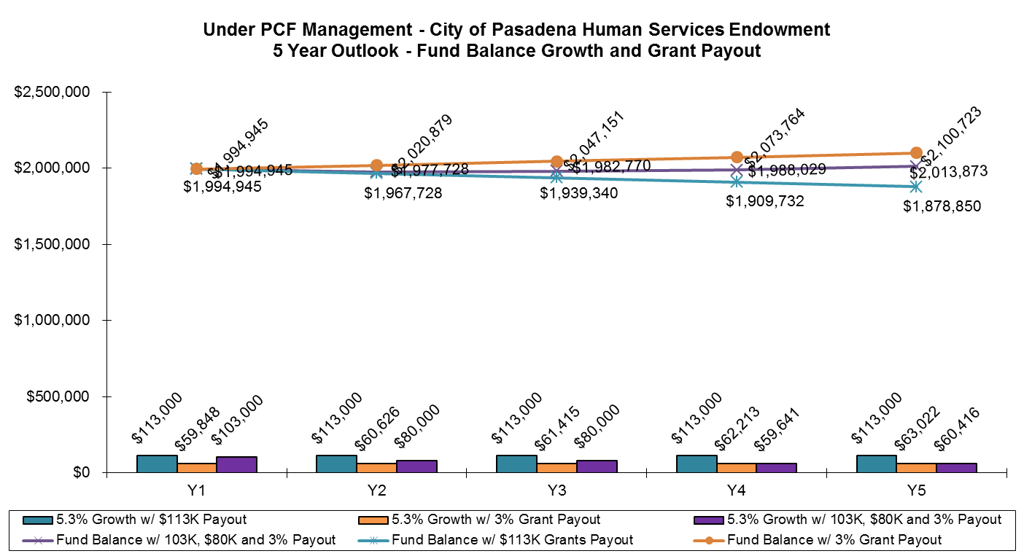
5 Year Fund Projection

