Slide 1
Michael Cacciotti Governing Board Member/South Pasadena Mayor Pro Tem Representing the cities of Los Angeles County/Eastern Region
Air Quality Update

Slide 2
State of the Air 2011
Health Impacts of Air Pollution:
Premature mortality, asthma & other lower respiratory symptoms, acute bronchitis,
cardiovascular disease, cancer risks from diesel particulates
Air Quality Challenge:
Mobile sources (e.g. cars, trucks, ships, trains, aircraft) create 90% of No_{x} (nitrogen oxides)
Attaining the federal 24-hr PM and ozone standards will require substantial Nox reductions beyond adopted rules
Federal Air Quality Standards Attainment Deadlines*:
Fine Particulates (PM_{2.5})
2014 (annual average standard)
2019 (24 hr average standard)
Ozone
2023
* Years attainment must be demonstrated; Clean Air Act deadlines are the following years.

Slide 3
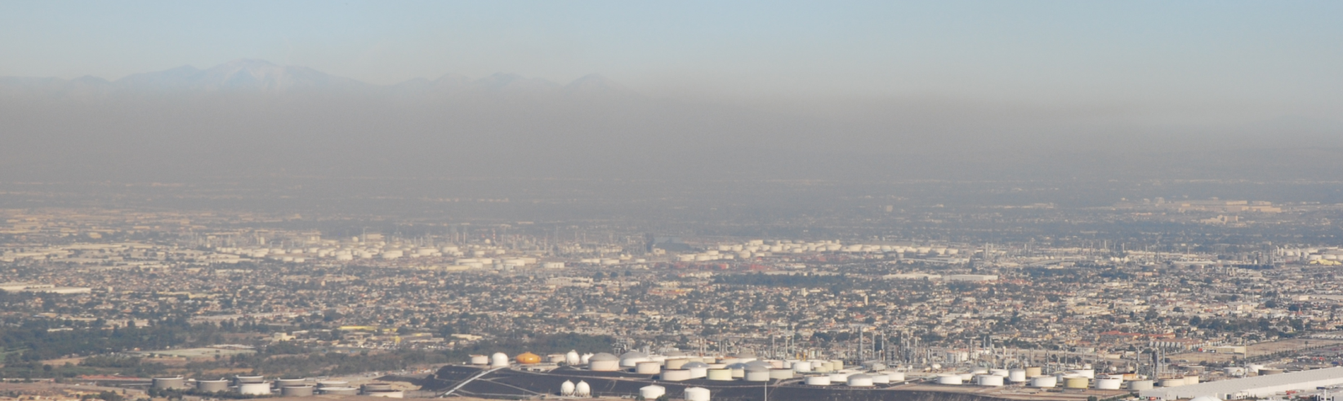
Health Consequences Ozone and Particulates
Premature mortality
Asthma & other lower respiratory symptoms
Acute bronchitis
Cardiovascular disease
Cancer risks from diesel particulates
Lost work days and school absences

Slide 4
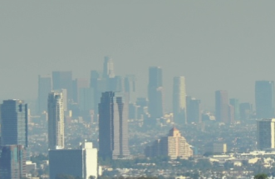
South Coast Air Basin Federal Air Quality Standards Attainment Deadlines*
Fine Particulates (PM2.5)
2014 (annual average standard)
2019 (24 hr average standard)
emissions that must be reduced:
nitrogen oxides
sulfur oxides
directly-emitted particulates
Ozone
2023
emissions that must be reduced:
nitrogen oxides
hydrocarbons
* Years attainment must be demonstrated; Clean Air Act deadlines are the following years.

Slide 5
MOBILE SOURCES CAUSE 80% OF AIR POLLUTION IN SOUTH COAST
OTHER SOURCES
20%
ON-ROAD
39%
OFF-ROAD
41%
EMISSION TYPES: NOx, SOx, PM2.5

Slide 6
NOx Emissions (SCAB, 2008)
Total = 860 Tons Per Day

Slide 7
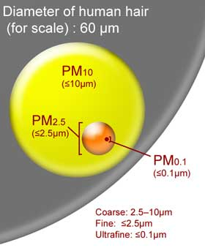
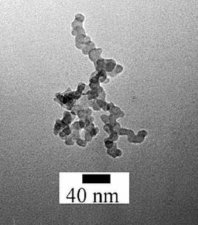
Ultrafine Particles

Slide 8
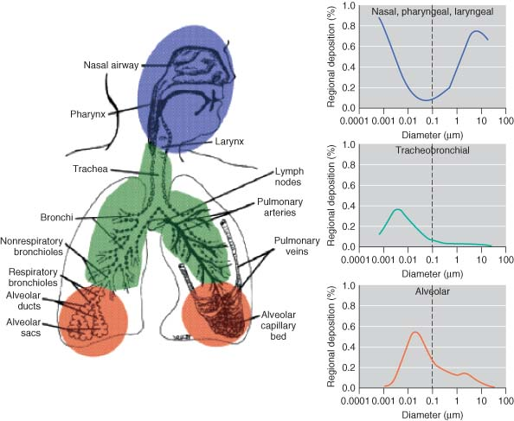
Ultrafine Particle Health Impacts

Slide 9
Ultrafine Particle Health Impacts
Ultrafine particulate material is more toxic than PM2.5 material
Ultrafine particles can cross cell membranes and can move into the circulatory system, brain, and other organs
UFP have been shown to cause adverse health effects related to stroke, systemic inflammation, vascular effects on diabetics, airway development, and asthma exacerbation
Suspected as one of the causative pollutants in near-traffic epidemiology studies

Slide 10
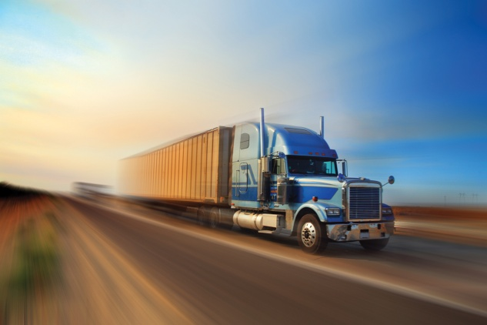
AQMD Technology Incentives & Funding for Cities
AB 2766 Subvention Funds
Carl Moyer Program
Proposition 1B – Goods Movement Program
Diesel Emissions Reduction Act (DERA)
Lower-Emission School Bus Program
Air Quality Investment Program (AQIP)

Slide 11
AB 2766 Subvention Funds

Slide 12
Carl Moyer Memorial Air Quality Standards Attainment Program
The Carl Moyer Program provides monetary grants to help businesses and public agencies clean up their heavy-duty diesel engines more than required by air pollution regulations.
The grants cover some or all of the cost difference between purchasing a newer cleaner engine/vehicle, and rebuilding the existing engine.
The 2011 Carl Moyer Program Announcement will be released in March due to modifications to the guidelines by CARB. The closing date to submit proposals will be extended to Friday, June 3, 2011.

Slide 13
Voucher Incentive Program (VIP)
The On-Road Heavy-Duty Vehicle Voucher Incentive Program (VIP) allows truck dealers to provide a discount to owners/operators to offset the purchase cost of a newer, low-emitting truck.
Total Funding Available under this Program: $6.8 Million (FY 09-10)
First-Come, First-Served Basis (no application deadline; open until funds are exhausted)

Slide 14
Surplus Off-Road Opt-in for NOx (SOON)
Program provides funding assistance to applicable fleets to repower or replace older, high-polluting, off-road diesel vehicles, which operate within South Coast AQMD’s jurisdiction, with new, cleaner engines and equipment.
Funding is available for of up to $60 million to accelerate the clean-up of Off-Road Diesel Vehicles.

Slide 15
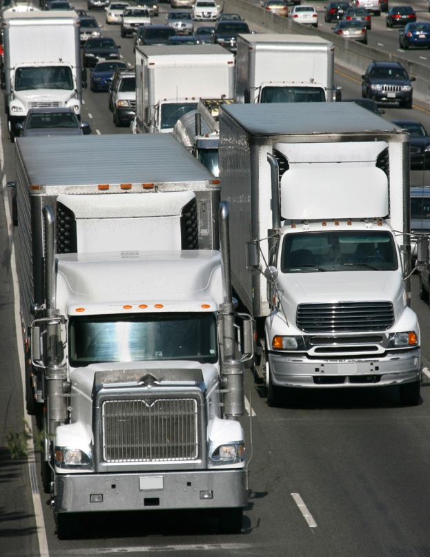
Proposition 1B
Proposition 1B approved by voters in November 2006
$1 billion for projects involved in movement of freight along California’s trade corridors
Funding available over 4 year period
55% allocated to LA/Inland region
Authorizing Legislations
Senate Bill 88
Assembly Bill 201

Slide 16
Diesel Emissions Reduction Act
(DERA) Funding
US EPA funding program
Awarded $1,065,465 to replace older diesel school buses with new CNG buses
Combined with Carl Moyer and AB 923 funds • Replaced 128 pre-1994 diesel school buses
Provides less polluting and safer school transportation for school children
Reduces public exposure to toxic diesel particulate matter

Slide 17
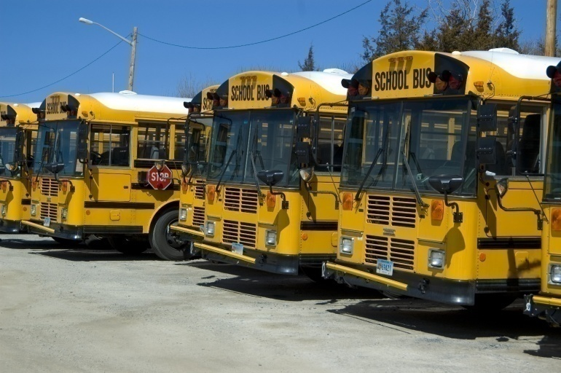
Lower-Emission School Bus Program
AQMD has awarded $106M to date for replacement & retrofit of school buses
Funds have been used to:
Replace 621 pre-1987 school buses with 535 CNG and 86 lower-emitting diesel buses
Retrofit 2,777 model year 1994 and newer school buses with particulate traps

Slide 18
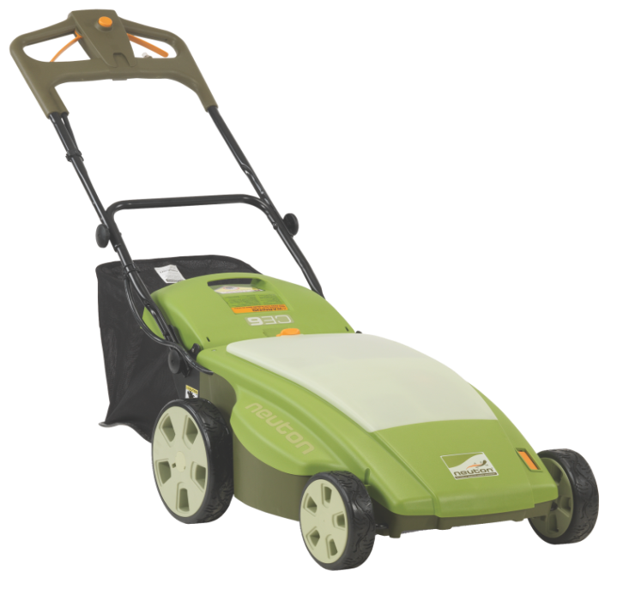
Lawnmower Exchange
Program reduces air pollution by
exchanging a working gasoline-powered
lawn mower for a new electric mower
at a deeply discounted price
9,380 new lawn mowers distributed in 2010 through 12 events across the Southland
Since the program‘s inception, AQMD has scrapped more than 37,800 highly polluting gasoline mowers, removing 80 tons of pollution from the Southland’s air

Slide 19
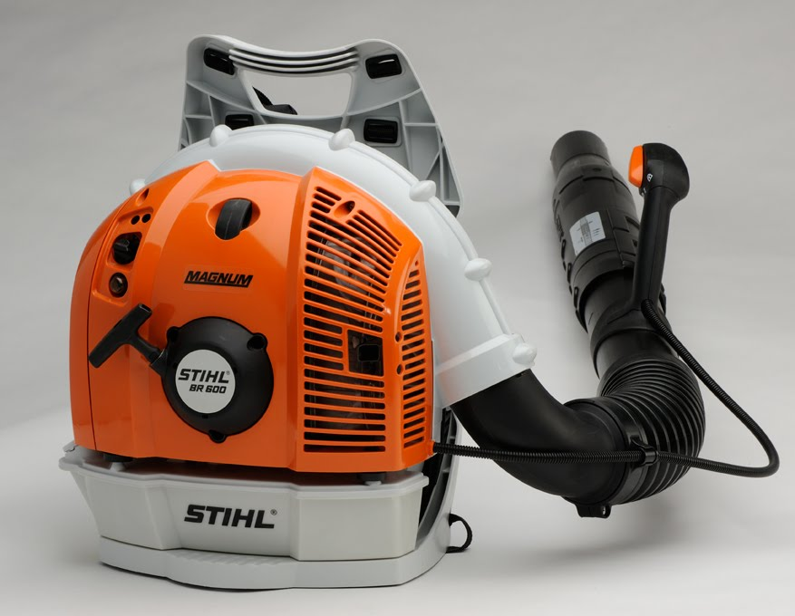
Leaf Blower Exchange
This program allows an older leaf blower to be exchanged for a low-polluting and lower-noise model. It is open to professional gardeners and landscapers who live and work in the SCAQMD’s four-county jurisdiction.
Reducing engine emissions from commercial leaf blowers is very cost-effective because the equipment is used for several hours a day, 5 or 6 days a week.

Slide 20
More Funding Opportunities
For more information
Please visit …
http://www.aqmd.gov/aqmd/funding.html

Slide 21
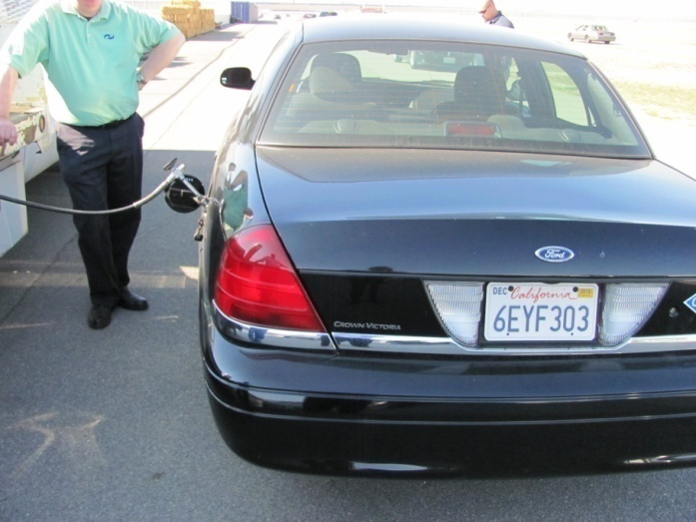
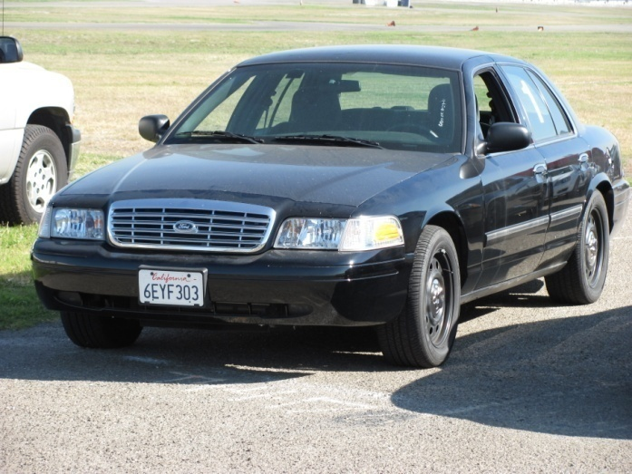
Cleaner Police Vehicles
Ford CVPI - 3.27: (CNG)
Full size four door sedan, rear wheel drive,4.6 Liter V-8 engine, 4 speed automatic transmission with overdrive and a 3.27 axle ratio.
L.A. County Sheriff – vehicle testing
Speed
Pursuit Course
Brake
Acceleration
Heat
Mechanical
Communication
Ergonomic Evaluation
Fuel Efficiency

Slide 22
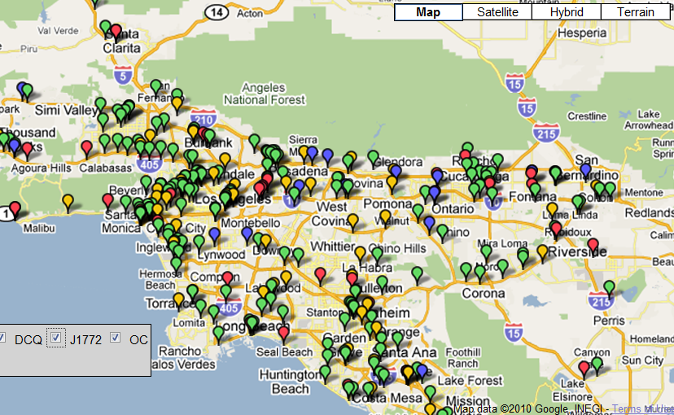
EV Infrastructure

Slide 23
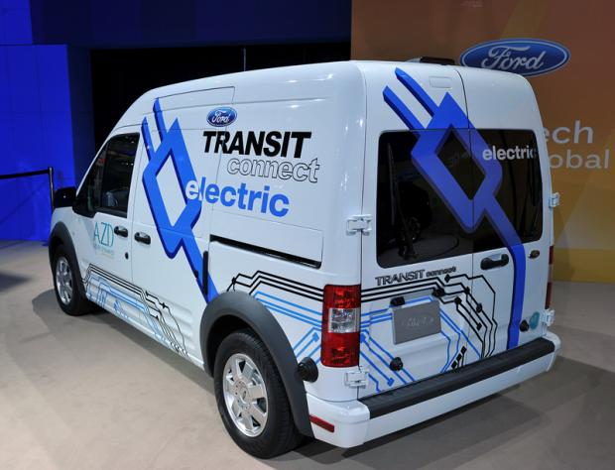
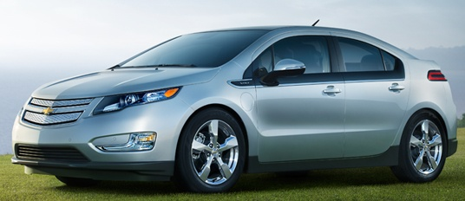
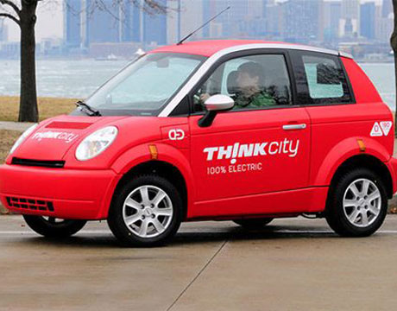
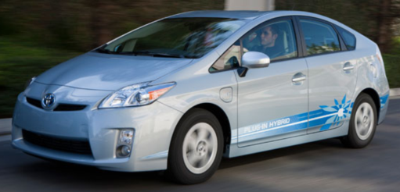
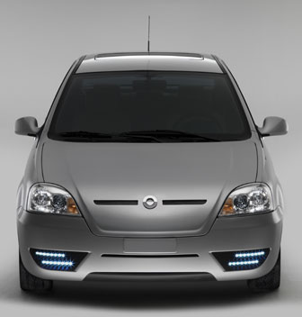
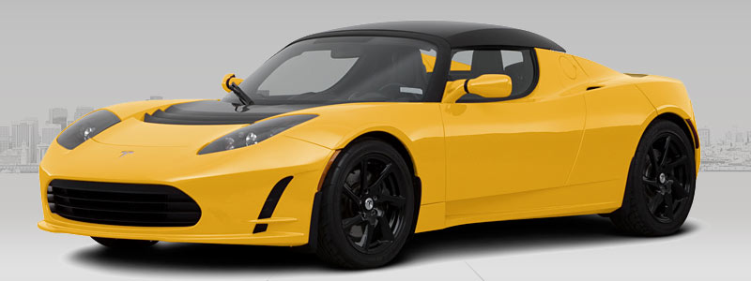
Plug-in Electric Vehicles in 2011

Slide 24
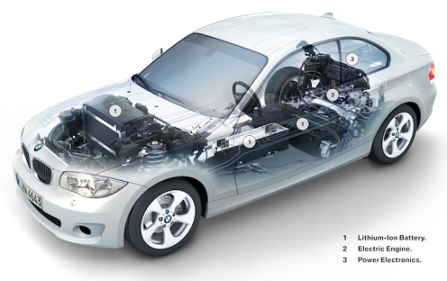
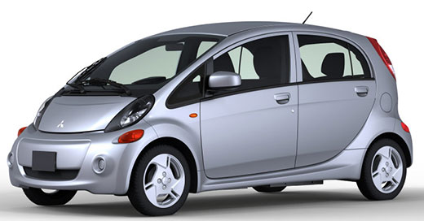
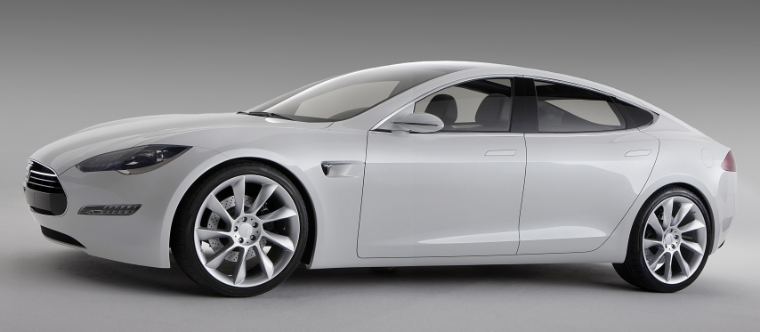
More Planned for 2012
Honda Fit Electric
BMW ActiveE All Electric Series 1
Mitsubishi iMiEV
Tesla Model S

Slide 25
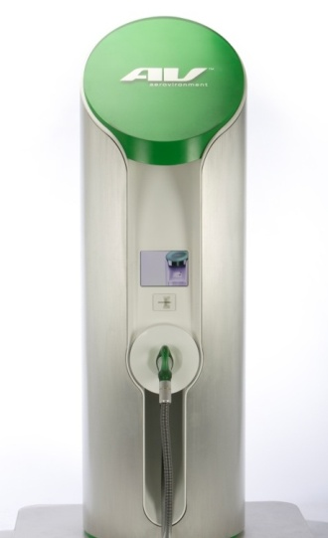
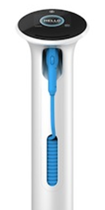
Proposal
Members to provide ~50% matching funds (in-kind and/or cash)
Minimum number of chargers to each Collaborative member
Project sites must be exempt from CEQA
Remaining chargers distributed based on
Number of charging locations
Greatest cost share
Shortest lead time

Slide 26
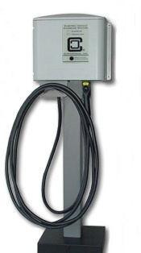
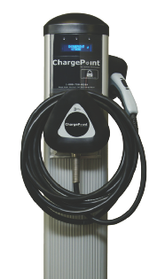
Program Funds
Maximum incentives per charger
$1,000 Level 1 (110V – 18 hours)
$2,500 Level 2 (220V – 8 hours)
$5,000 Level 3 (400 V – 30 minutes)
AQMD to receive 5% administrative fee
Total $798,750 for charger installations

Slide 27
AQMD Involvement in Pasadena
Events hosted/participated:
Lawn Mower Exchange 2008 – 2011
Leaf Blower Exchange 2008 – 2011
Neighborhood Green Fair, Unitarian Universalist Church of Pasadena 2009
Green Tech Connect Forum 2009
The Green Economy Symposium, Pasadena City College 2009
3rd Annual Family Health & Safety Fair 2009
Villa Parke Census Festival 2010
Women in Green Forum 2010
Conference on Aging, First Church of Nazarene 2011
AQMD Grants:
Tree-planting Grant 2010 ($15,000)
Dry Cleaner Grants ($45,000)

Slide 28
Local Government Liaison: Rainbow Yeung (909) 396-3373 / ryeung@aqmd.gov
Useful Numbers for Cities
AQMD’s Toll Free Hot Line (800) CUT-SMOG
Small Business Hotline (909) 396-3529

Slide 29
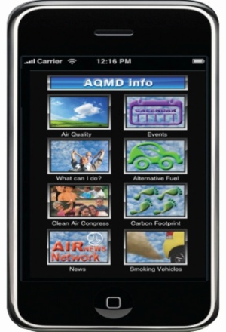
Connect with us!
www.Facebook.com/CleanAirConnections
www.Twitter.com/Connect2ClnAir
@Connect2ClnAir
www.YouTube.com/SouthCoastAQMD

Slide 30
Thank You!

