Slide 1
Devil’s Gate Dam
& Reservoir
Environmental Impact Report
&
Interim Operational Measures
Steve Sheridan, P.E.
Los Angeles County
Department of Public Works

Slide 2
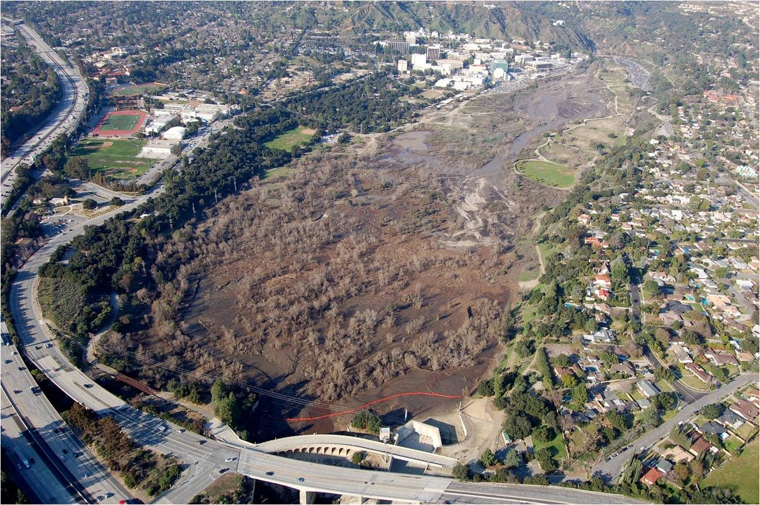

Slide 3
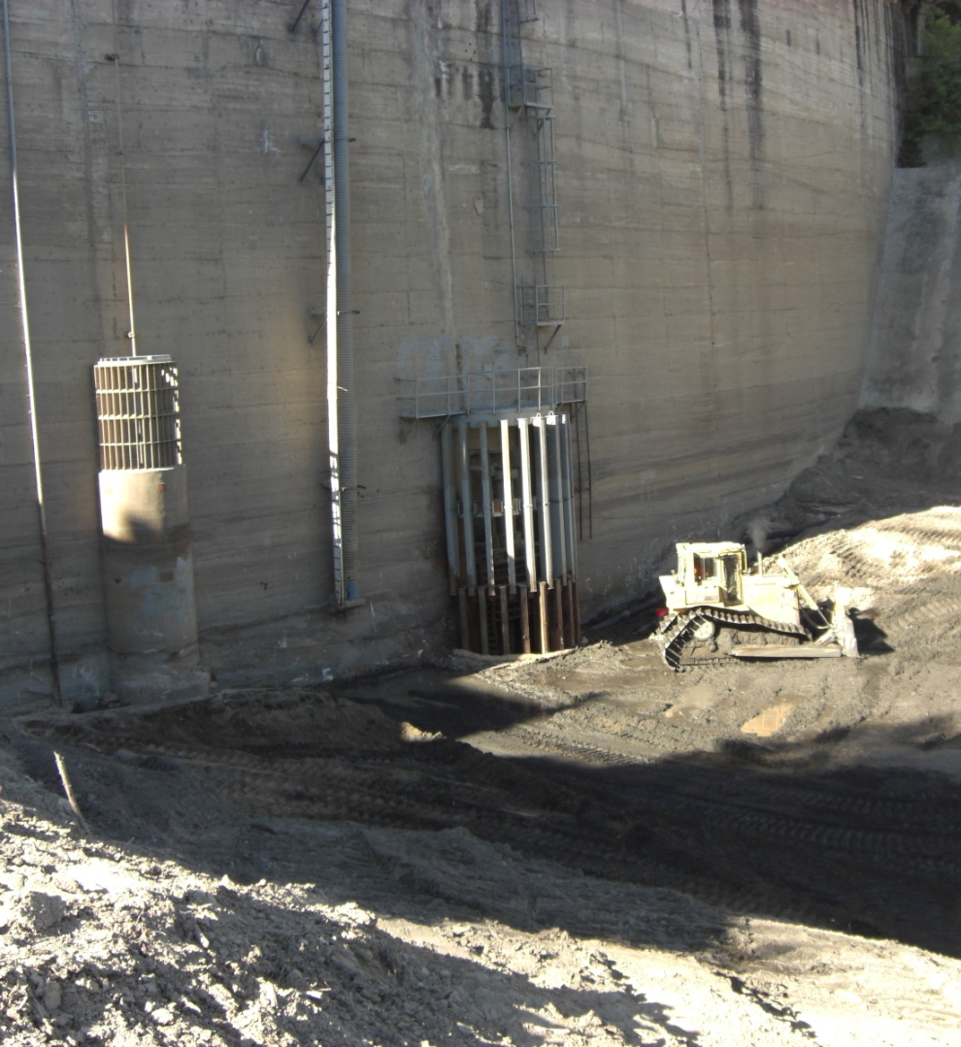
Condition Assessment
Same trashrack
September 2009
January 2011

Slide 4
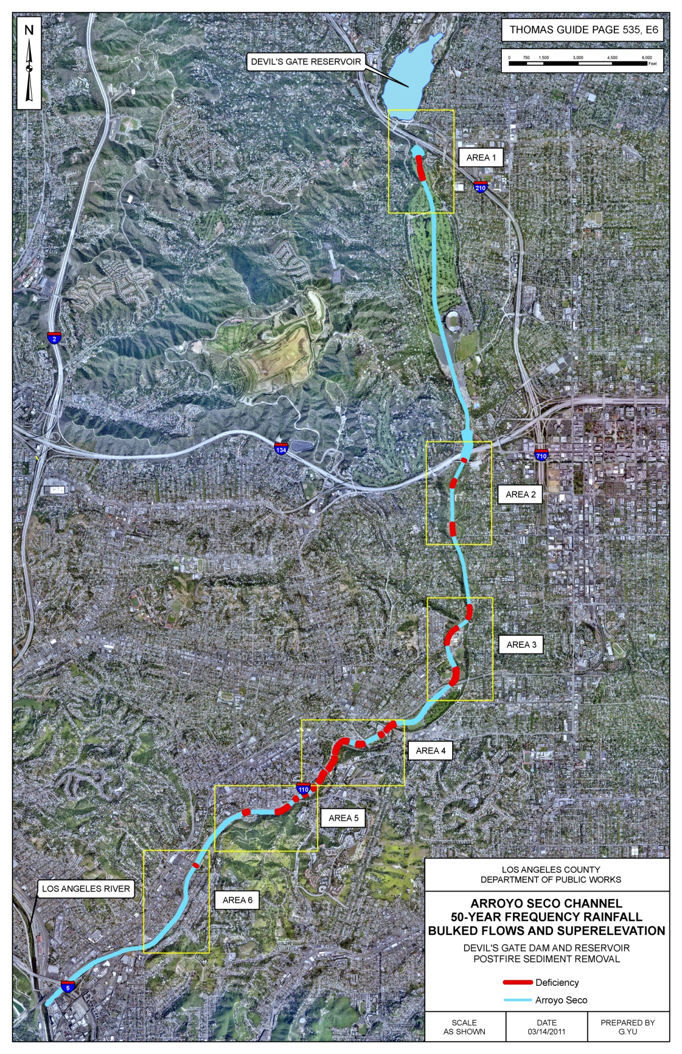
Flood Hazard Risk

Slide 5
Environmental Impact Report

Slide 6
Interim
Operational
Measures

Slide 7
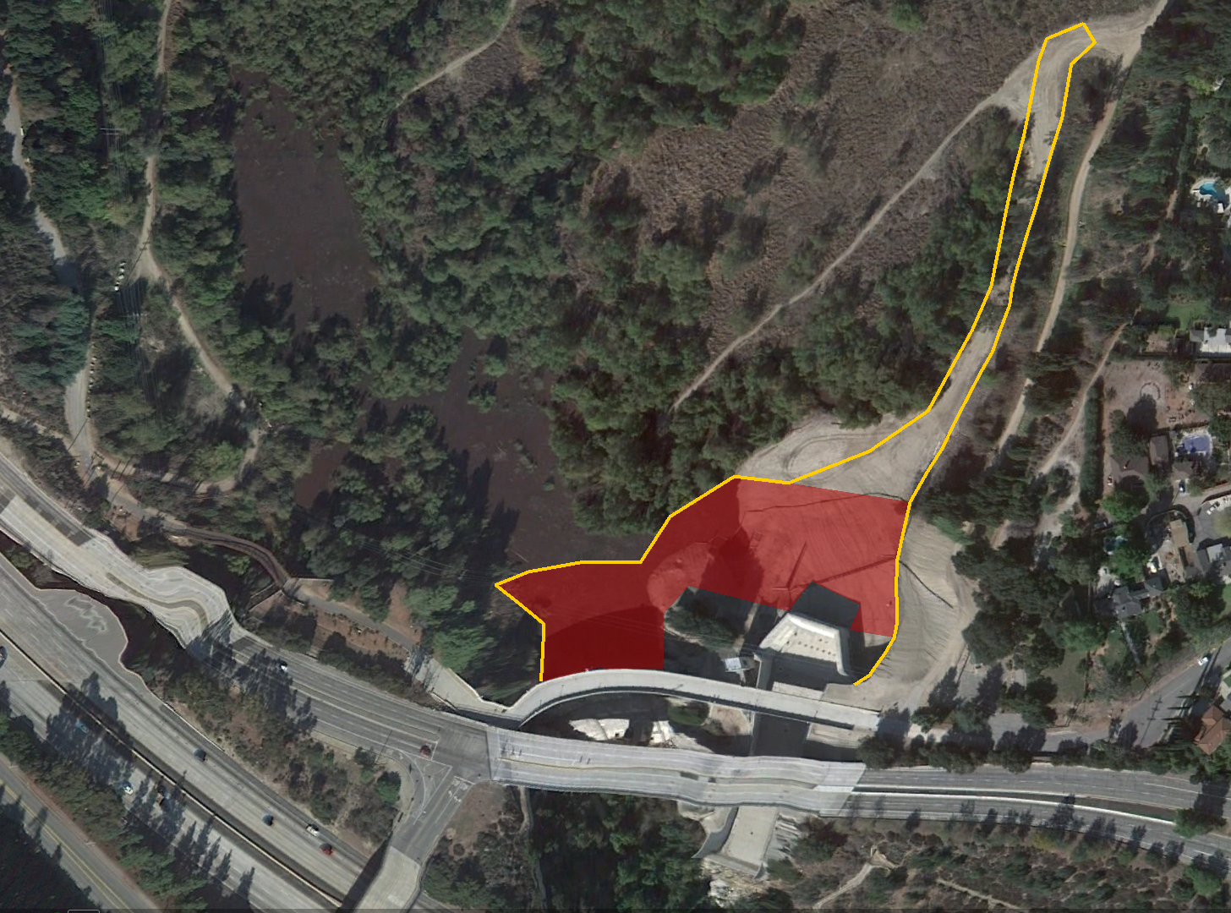
Limits of work

Slide 8
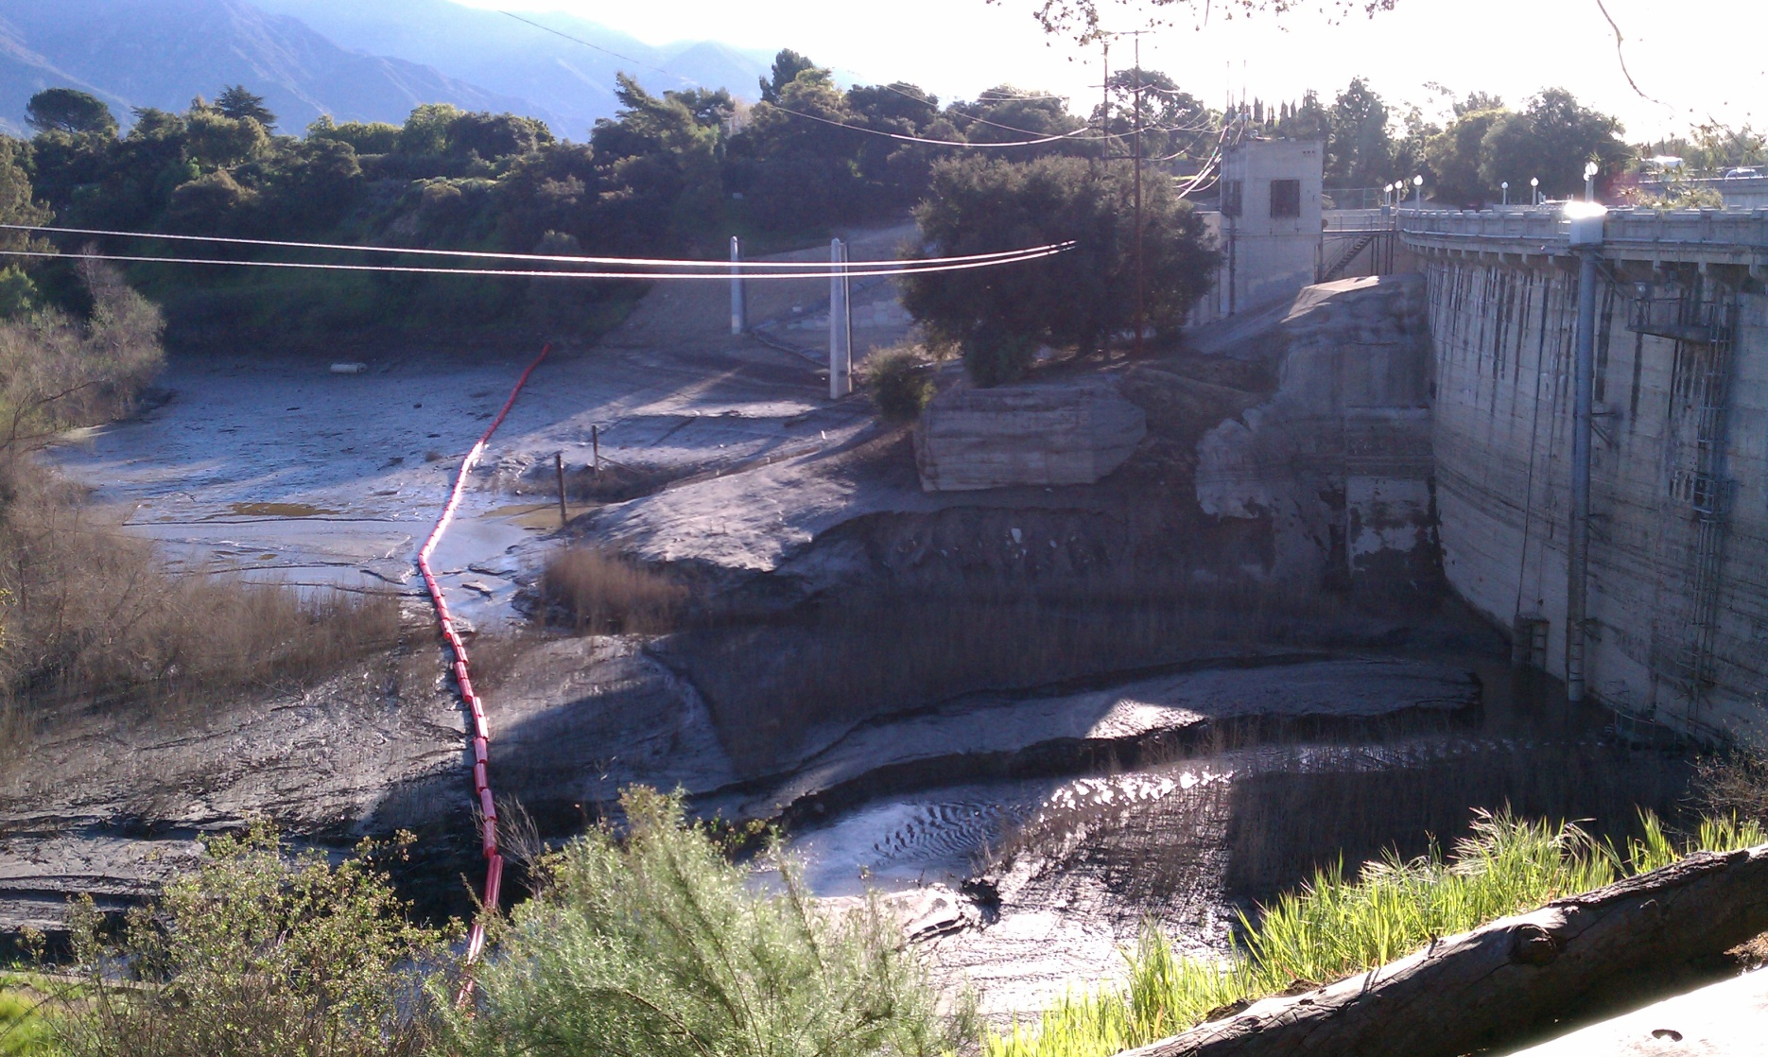
Interim Operational Measures
Remove an estimated 25,000 CY of sediment from an area approximately 100 feet upstream of the dam face.
≈ 100’
Re-establish the access road along east abutment

Slide 9
Interim Operational Measures
Replace approximately 100 feet of damaged ladder system on the face of the dam.
Extend the height of existing sluice gate trash rack approximately 32 feet.
Reduce the bar opening width of the existing sluice gate trash rack.

Slide 10
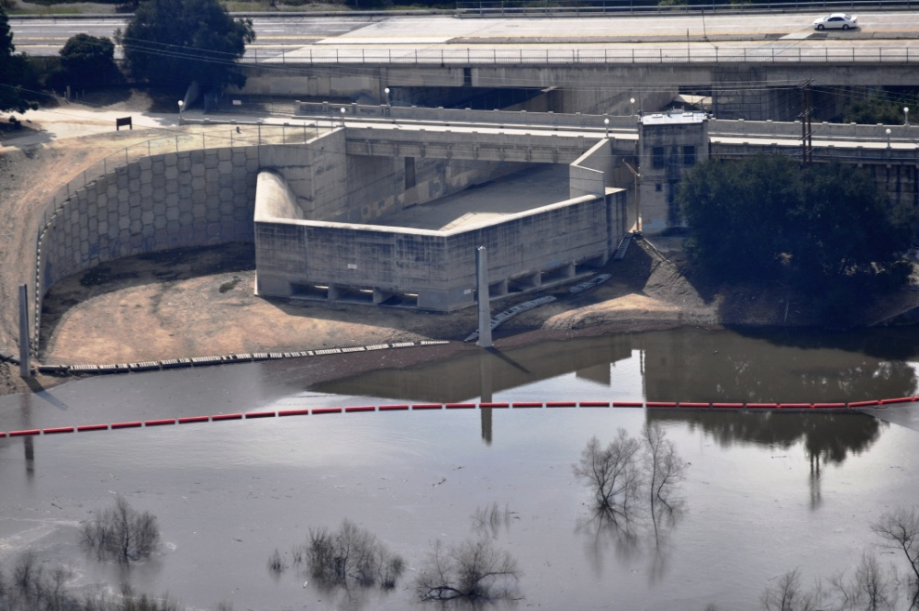
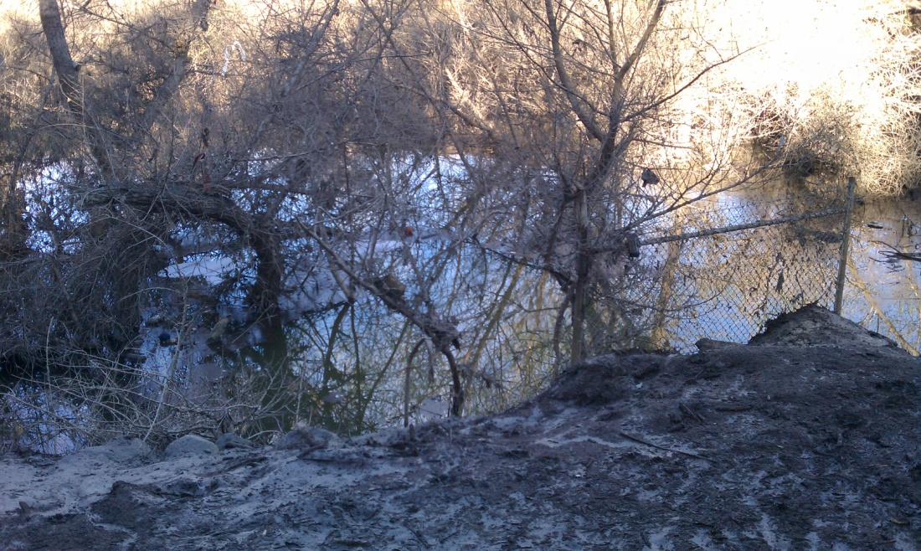
Interim Operational Measures
Install new catwalk around the spillway ports.
Replace the existing wooden boom logs that are employed upstream of spillway ports to trap floating debris and install new anchor points.
Modify the Altadena West Storm Drain to allow discharge in the event the outlet becomes blocked by sediment.

Slide 11
Regulatory Agencies
Division of Safety of Dams
Department of Fish and Game
Regional Water Quality Control Board
US Army Corps of Engineers

Slide 12
Summary
Contact Information
Steve Sheridan, Principal Engineer
Los Angeles County Department of Public Works
Water Resources Division
(626) 458-6102
ssheridan@dpw.lacounty.gov
For a copy of the Board Report, go to:
http://dpw.lacounty.gov/wrd/Removal/index.cfm
And select Devil’s Gate Dam and Reservoir

