Slide 1
Religious Institutions Housing Discussion
City Council
October 5, 2020

Slide 2
Executive Summary
The City Manager has initiated Text Amendments to address two separate issues:
Temporary homeless shelters associated with Religious Institutions (potential RV use);
Permanent Affordable Housing on Religious Institutional Property;
The Planning Commission has conducted study sessions on each item.
The City Council has requested that staff provide an update/information to the Council.

Slide 3
Purpose of Tonight’s Meeting
Provide Background
Provide Examples
Identify Critical Issues
Receive Comments from the City Council
Next Steps

Slide 4
Background
Recent efforts by faith-based organizations have prompted discussion of both temporary and permanent housing on religious properties.
Several bills considered at the State level; only one was passed (AB 1851).
The City Manager has initiated a Zoning Code Amendment to address regulations related to housing on these properties.

Slide 5
Background – Temporary Housing
“Religious Institutions with Temporary Homeless Shelter” exists as a conditionally permitted use in various zones.
Specific standards currently exist allowing religious facilities to operate temporary homeless shelters without obtaining a CUP, including:
Within residential, CO, and PS zones, if the religious facility was authorized through a CUP;
No rent or fees may be charged for services;
No more than 10 homeless persons in residential district;
Maximum stay of 60 days;

Slide 6
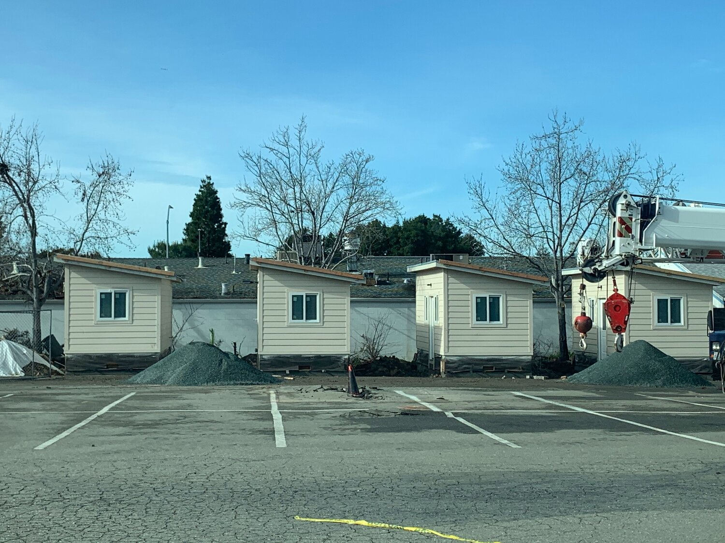
Example – Hayward
First Presbyterian Church of Hayward
Built 6 mobile “tiny homes” in parking lot
Temporary transitional housing for 6-12 individuals
Stay up to 18 months

Slide 7
Background – Permanent Housing
Religious facilities are currently allowed in a variety of zones, either by-right or conditionally
Housing is allowed generally in most zoning districts – not permitted generally in CG or IG
The allowed density/FAR, setbacks and height are regulated by zoning code and the Church and any proposed housing would need to comply with all standards
AB 1851 eliminated the need modify or provide parking for affordable housing on these properties

Slide 8
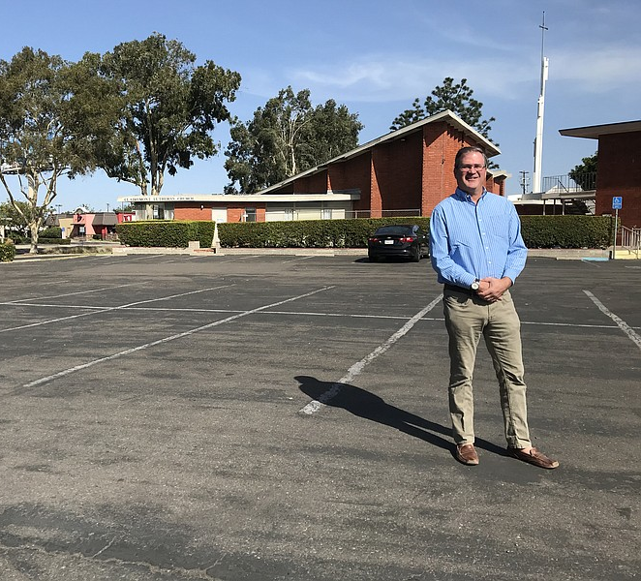
Example – San Diego
Clairemont Lutheran Church
Seeks to build approximately 12 low-income homes on existing parking lot
City eliminated parking standards based on pew count and reduced overall requirement

Slide 9
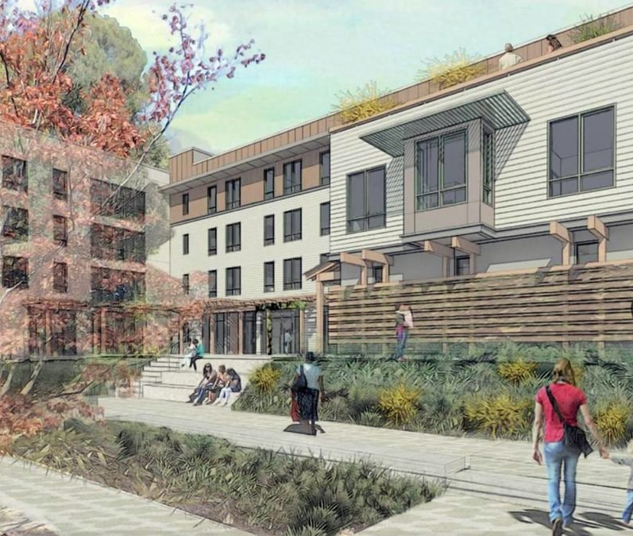
Example – Walnut Creek
St. Paul’s Episcopal Church
45 low-income units currently under construction
Project includes community centers with services for homeless and working poor on-site

Slide 10
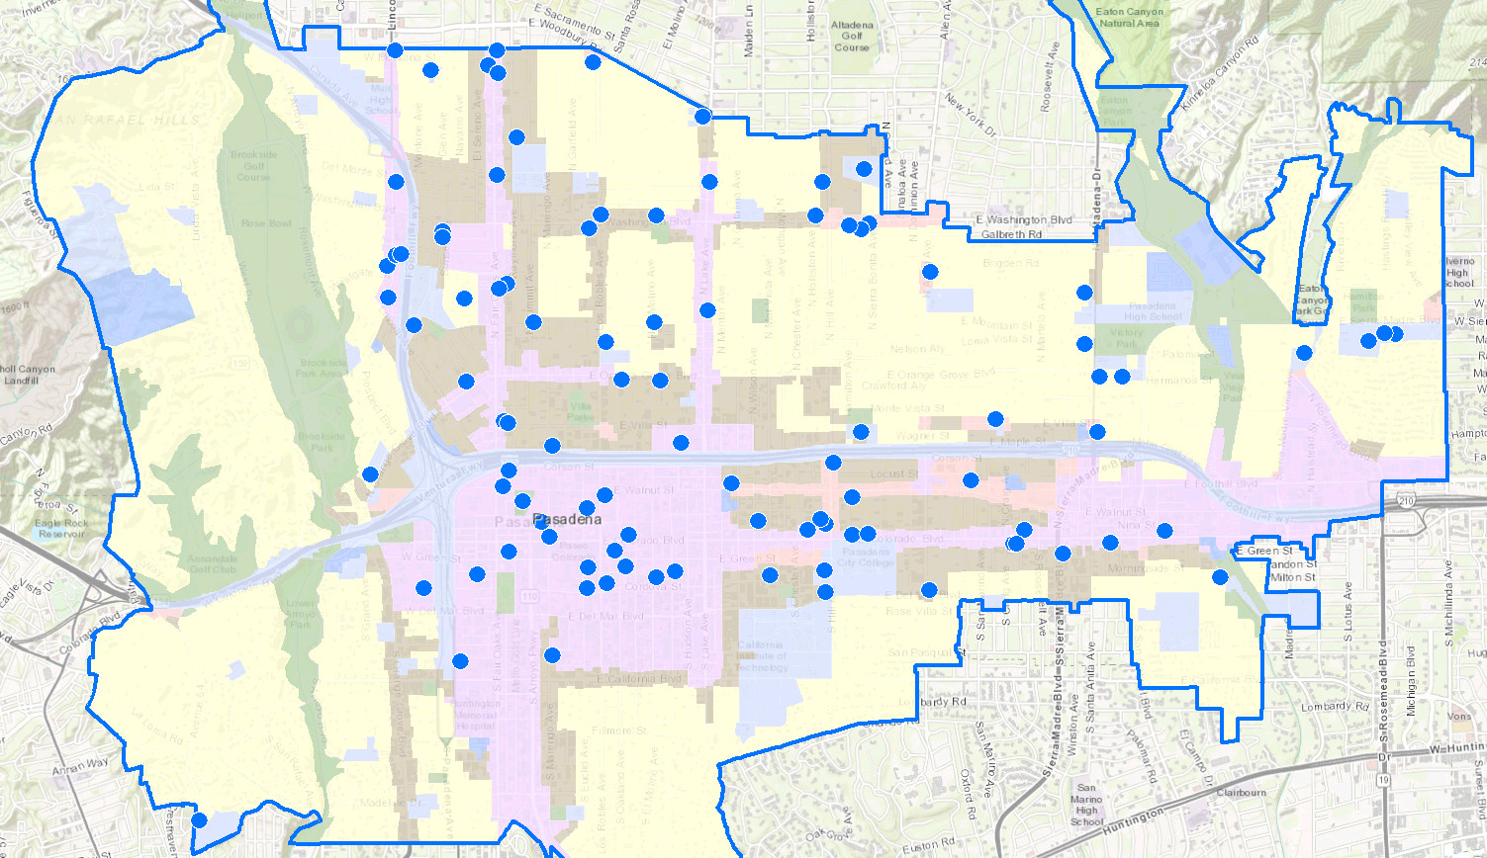
Locations of Religious Institutions

Slide 11
Discussion – Temporary Housing
Staff seeks input and direction on the following topics:
Appropriate changes for zones that permit, conditionally permit, or prohibit Temporary Homeless Shelters
Increasing maximum stay period (currently 60 days) and other standards
Expanding definition of “temporary facilities” to include trailers, recreational vehicles (RVs), or other non-permanent structures
Include provisions for utility connections for trailers and RVs
Amending code sections prohibiting the parking of RVs in certain locations on private property and duration of time spent on private property

Slide 12
Discussion – Permanent Housing
Staff seeks input and direction on the following topics:
Appropriate zones and site locations for permanent housing on land owned by religious facilities
Development and operating standards
Minimum lot sizes, setbacks, height and density requirements
Open space requirements
Parking requirements
Affordability requirements
Amenities required
Design Review

Slide 13
Next Steps
Council Direction
Proceed with Amendments on open-ended basis
Proceed with Amendments with specific focus on certain housing types or regulatory framework
Do not proceed with Amendments at this time
Virtual Community Meeting
Prepare Zoning Code Amendment
Bring item to Planning Commission for recommendation
Return to City Council

Slide 14
Church Housing Discussion
City Council
October 5, 2020

Slide 15
CA Govt. Code Section 65583.2
Appropriate densities for accommodating lower-income households is defined in Section 65583.2(c)(3)(B)
For jurisdictions in metropolitan counties such as Pasadena, sites must allow at least 30 du/ac.

Slide 16
Income Categories
Current Area Median Income (AMI) for Los Angeles County is $77,300, as published by HCD.
Very Low Income = <50% of AMI
Low Income = 51-80% of AMI
Moderate Income = 81-120% of AMI
Above Moderate = >120% of AMI

