Slide 1
Declarations of Surplus Property 78 N. Marengo Ave., 255 E. Union St., 95 N. Garfield Ave. & 280 Ramona St.
City Council
October 5, 2020

Slide 2
Introduction
This item is before the City Council now rather than in conjunction with a proposed project because the Council needs to take this action 60 days before entering into an agreement with a developer. There is no proposed project at this time.
Once a project application is submitted to the City, it will undergo full environmental review and the required approval process. Tonight’s issue is a prerequisite to the consideration of any project.
Tonight’s review does not include consideration of future use of the site or development standards of any proposed development.

Slide 3
Background
City purchased YWCA properties in 2012 with intent to make the property and adjacent City-owned properties available for private development to ensure preservation of the historic building.
After a protracted process outlined in the staff report, the City is reviewing new development proposals and considering selecting a developer that would develop a project that is consistent with the goals set forth by the City Council.
In order to address changes in state law and pursue a private development, the affected properties need to be declared surplus prior to entering into a sale or long-term lease agreement with a developer.

Slide 4
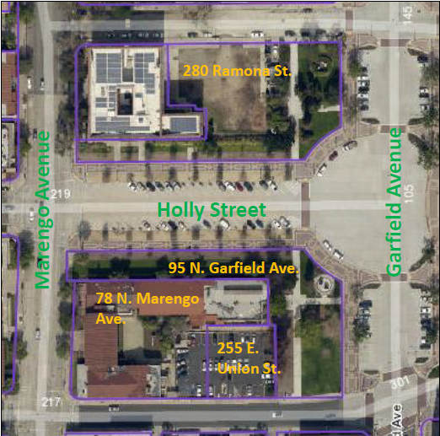
Properties in Question

Slide 5
State Surplus Land Act
Surplus land is land owned in fee simple by the City for which the City Council takes formal action in a regular public meeting declaring the land is surplus and not necessary for the City’s use.
No real property shall be disposed of until the location, purpose and extent of such disposition has been submitted to and reported upon by the planning agency as to conformity with the adopted general plan.
Although not strictly required by state law, the Planning Commission determined on September 23, 2020 that the proposed disposition is consistent with the General Plan.

Slide 6
State Surplus Land Act Analysis
The four subject properties are not being used, nor are they planned to be used pursuant to a written plan adopted by the City Council, for City work or operations.
The sites are not needed for the City’s use, as defined in the State Surplus Lands Act, and are proposed to be made available through sale or long-term lease to a private developer or developers.
The City is financially unable to rehabilitate the YWCA building and is seeking to partner with a private developer on a project that would rehabilitate the structure and provide supporting uses to ensure adequate return to the developer on the large investment needed for rehabilitation.

Slide 7
State Surplus Land Act Analysis
The properties have been zoned and planned for development since the 1920’s and are not specified in any planning documents as being zoned or planned for public use.
On April 8, 2019, the City Council identified setback and height parameters that would be imposed on any potential development that would be undertaken on these properties.
To ensure that the Council’s goals for the project are met, appropriate steps will be taken during any potential negotiations with private developers to ensure that these parameters are followed.

Slide 8
PMC Requirements for Surplus Property
“Surplus real property,” is defined as “real property of the city not needed for the purpose for which it was acquired or for any other public purpose” prior to its sale (which includes long-term leases).
PMC also establishes competitive sale requirement (i.e., sale to the lowest bidder) and a procedure for it to be waived.
Declaration & waiver only currently required for 280 Ramona Street – staff is also requesting Council approval on these actions.

Slide 9
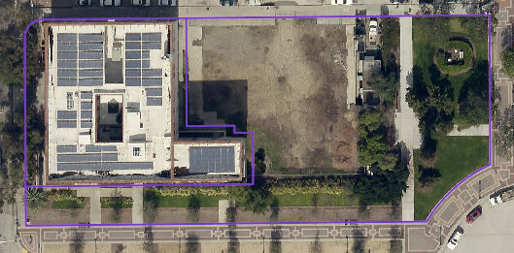
City Surplus Land Declaration
Purposes of original land purchases, 280 Ramona St. purchased in two separate transactions and joined together by a lot line adjustment.
“Dirt lot” acquired in conjunction with the rehabilitation of the YMCA for no specific stated purpose and is not needed for any City purpose.
“Dirt lot”
“Landscaped
lot”

Slide 10
Purpose of Landscaped Lot Purchase
Purchased in 1923 along with other properties in the vicinity for “the construction and completion thereon of a building, together with suitable appurtenances, grounds and approaches, for City Hall purposes.”
1921: State Law changed to allow the issuance of a single bond for several municipal improvements in one group if city planning commission and voters determine that the improvements constitute a “City Plan” (later cited by the 1923 City Attorney as the primary reason for the ballot propositions to be discussed).
April 1922: City Planning Commission created in Pasadena

Slide 11
Purpose of Landscaped Lot Purchase
January 1923: Bennett, Parsons & Frost prepare a drawing titled “Location Plan of Public Buildings with their Approaches” – a conceptual plan for the Civic Center.
May 11, 1923: Planning Commission approves Resolution 2 to acquire specific land and construction City Hall, Public Library and Municipal Auditorium and that these improvements constitute a City Plan.
May 24, 1923: City Council approves Ord. 2116 providing for a special election regarding the City Plan approved in Planning Commission Resolution 2.

Slide 12
Purpose of Landscaped Lot Purchase

Slide 13
Purpose of Landscaped Lot Purchase
Note: No drawings included in resolution
Full text in Att. D
Includes legal description of properties to acquire

Slide 14
Purpose of Landscaped Lot Purchase
June 1923: Two propositions were placed on the ballot to ask voters:
Note: No drawings included in ballot

Slide 15
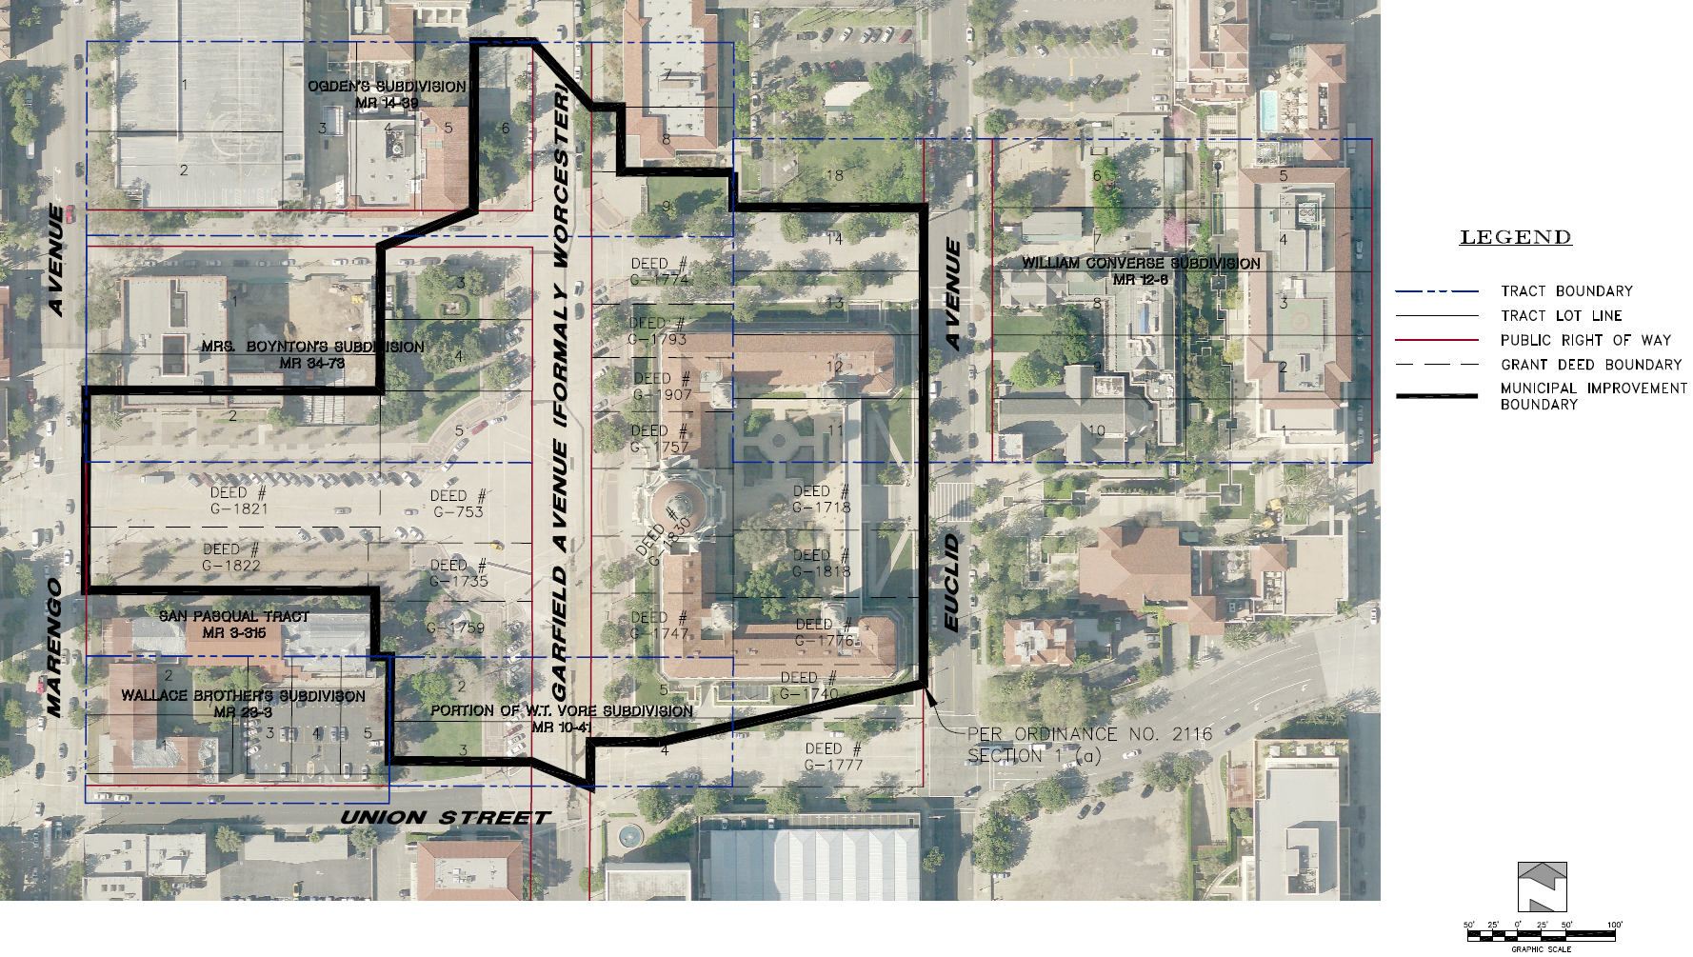
Purpose of Landscaped Lot Purchase
Attachment E
Prepared by City’s Lead Surveyor

Slide 16
Purpose of Landscaped Lot Purchase
1910 Sanborn Map (Attachment E)

Slide 17
Purpose of Landscaped Lot Purchase
Existing depth of the landscaped areas along Garfield Avenue corresponds to the actual depth of the properties acquired along Worcester (later renamed to Garfield) Avenue.
Subsequent to passing of the propositions, a design competition was held for the three buildings.
Bennett then met with the Planning Commission and the selected architects in late 1924 and revised the Civic Center Plan to reflect and respond to these designs.

Slide 18
Purpose of Landscaped Lot Purchase
November 1924 article reports on results of competition and changes to plan by Bennett.
1925 Plan more closely resembles existing conditions & landscaped lot shown as “automobile parking (future building site)” with a 25-foot deep landscaped area along Garfield Ave.

Slide 19
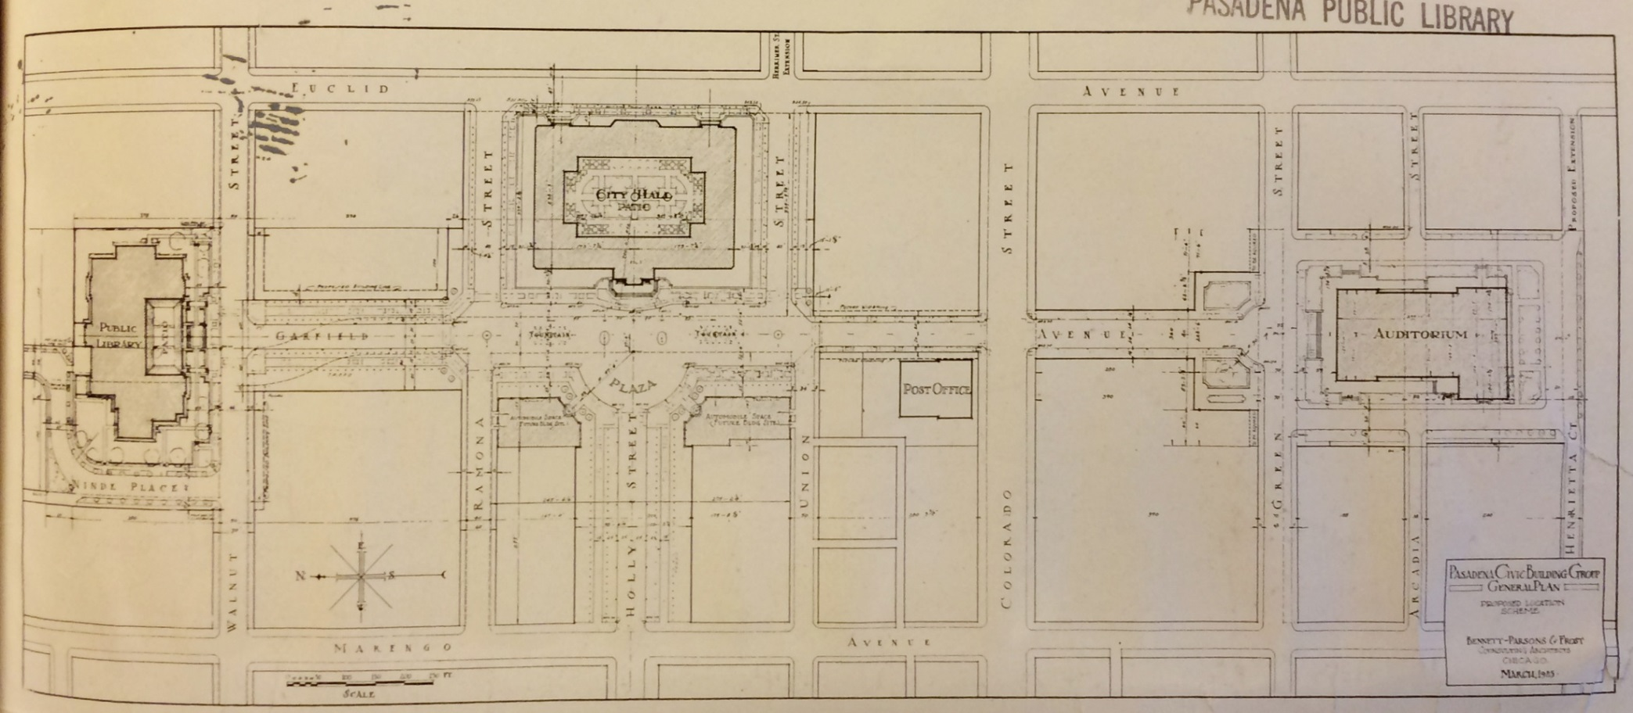
Purpose of Landscaped Lot Purchase
1925 Bennett Plan (Attachment G)

Slide 20
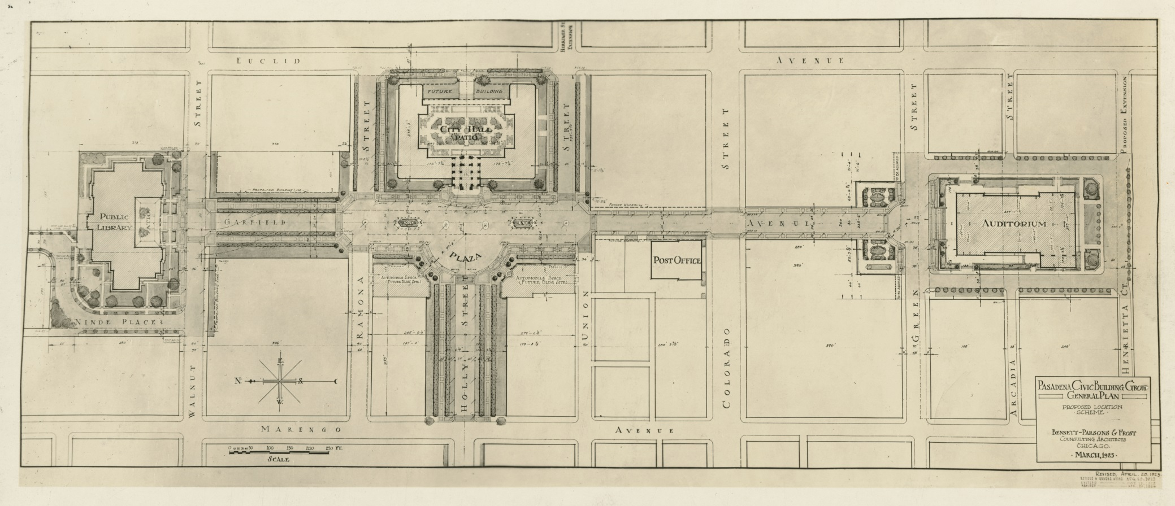
Purpose of Landscaped Lot Purchase
1926 Bennett Plan (Attachment G)

Slide 21
Purpose of Landscaped Lot Purchase – Summary
Land was purchased following voter approval of propositions to acquire land and build City Hall building.
Properties were bought as they were configured at the time.
All plans for the Civic Center drawn by Bennett, Parsons & Frost indicate a landscaped area along Garfield Avenue with between 51% and 77% shallower depth than exists today.

Slide 22
Purpose of Landscaped Lot Purchase – Conclusion
Based on this information, it is clear that the City Council intended to build on a portion of this land or to declare it surplus property in the future to allow private development.
Bonds that were issued were used for the purposes intended in the ballot language and have been paid. No covenants were established restricting use of the land in the future.
Current Municipal Code allows for the City Council to declare City-owned land surplus property to allow it to be used for a different purpose than that for which it was originally purchased.

Slide 23
Exemption from Competitive Sale Requirement
PMC requires surplus property to be sold only after an open and competitive bidding process to the highest bidder.
However, the PMC also provides that the City Council may make findings that “an extraordinary and overriding public benefit will be achieved” related to:
Public parking,
Low-cost housing,
A public service facility
A museum or other cultural or artistic institution, or
The economic and public well-being of other properties in the immediate vicinity.”

Slide 24
Exemption from Competitive Sale Requirement
Staff recommends that the City Council find the sale or lease of 280 Ramona Street exempt from the competitive sale requirement related to the economic and public well-being of other properties in the immediate vicinity.
This will allow the City Council to enter into a sale or lease with the bidder most suited to develop a project consistent with its goals for the site rather than with the highest bidder.

Slide 25
Planning Commission Recommendation
On September 23, 2020, the Planning Commission, by a vote of 4-2, adopted the following findings:
Found that the proposed action is not subject to the California Environmental Quality Act (CEQA) pursuant to State CEQA Guidelines Sections 15060 (c)(2), 15060 (c)(3), and 15378, as the activity will not result in a direct or reasonably foreseeable indirect physical change in the environment and is not a “project;” and
Found that the proposed disposition of the properties at 78 N. Marengo Avenue, 255 E. Union Street, 95 N. Garfield Avenue & 280 Ramona Street, following declarations that such properties are surplus property, is consistent with the General Plan.

Slide 26
Planning Commission Recommendation
The Commission was also asked to consider the following recommendation, which failed by a vote of 3-3:
Recommend that the City Council declare the property at 280 Ramona Street as surplus property and exempt from the competitive sale requirement under Pasadena Municipal Code Chapter 4.02
Discussion surrounding this recommendation was focused around concerns about lack of control over potential future development that might occur on this property (i.e., inability to make the finding without a specific project proposal), lack of evidence to support a determination that the property is not needed for another City use, as well as loss of open space.

Slide 27
Staff Recommendation
Find that the proposed action is not subject to the California Environmental Quality Act (CEQA) pursuant to State CEQA Guidelines Sections 15060 (c)(2), 15060 (c)(3), and 15378, as the activity will not result in a direct or reasonably foreseeable indirect physical change in the environment and is not a “project;”
Adopt a resolution declaring the properties at 78 N. Marengo Avenue, 255 E. Union Street, 95 N. Garfield Avenue & 280 Ramona Street as surplus property under California Government Code Sections 54220-54234; and
Adopt a resolution declaring the property at 280 Ramona Street as surplus property and exempt from the competitive sale requirement under Pasadena Municipal Code Chapter 4.02.

Slide 28
Declarations of Surplus Property 78 N. Marengo Ave., 255 E. Union St., 95 N. Garfield Ave. & 280 Ramona St.
City Council
October 5, 2020

